Slide 1
How to find and remove unproductive rules in a grammar
New! How to find and remove unreachable rules in a grammar
Roger L. Costello
May 1, 2014

Slide 2
Objective
This mini-tutorial will answer these questions:
  What are unproductive grammar rules?

Slide 3
Objective
This mini-tutorial will answer these questions:
  What are unproductive grammar rules?
  Why remove unproductive rules?

Slide 4
Objective
This mini-tutorial will answer these questions:
  What are unproductive grammar rules?
  Why remove unproductive rules?
  Is there an intuitive algorithm to find unproductive rules?

Slide 5
Objective
This mini-tutorial will answer these questions:
  What are unproductive grammar rules?
  Why remove unproductive rules?
  Is there an intuitive algorithm to find unproductive rules?
  Intuition is a dangerous master; is there a precise, formal algorithm to find unproductive rules?

Slide 6
Objective
This mini-tutorial will answer these questions:
  What are unproductive grammar rules?
  Why remove unproductive rules?
  Is there an intuitive algorithm to find unproductive rules?
  Intuition is a dangerous master; is there a precise, formal algorithm to find unproductive rules?
  Can we identify and eliminate unproductive rules in XML Schemas?

Slide 7
Objective
This mini-tutorial will answer these questions:
  What are unproductive grammar rules?
  Why remove unproductive rules?
  Is there an intuitive algorithm to find unproductive rules?
  Intuition is a dangerous master; is there a precise, formal algorithm to find unproductive rules?
  Can we identify and eliminate unproductive rules in XML Schemas?
  New! What are unreachable rules, how do we identify them, and how do we eliminate them?

Slide 8
Context-free grammars
The following discussion shows a systematic procedure for finding and eliminating unproductive rules in context-free grammars.
  Finding and eliminating unproductive rules is decidable for context-free grammars.
There is no procedure for finding and eliminating unproductive rules in context-sensitive or phrase-structure grammars.
  Finding and eliminating unproductive rules is undecidable for context-sensitive and phrase-structure grammars.

Slide 9
S
S
A
B
→
→
→
→
A
B
a
bB
This is a productive rule. It generates a string: S → A → a

Slide 10
S
S
A
B
→
→
→
→
A
B
a
bB
This is an unproductive rule. It does not generate a string: S → B → bB → bbB → bbbB → bbbbB → … (the production process never terminates)

Slide 11
Definition
A rule is productive if at least one string can be generated from it.
A productive rule is also known as an active rule.

Slide 12
Why remove unproductive rules?
Unproductive rules are not a fundamental problem: they do not obstruct the normal production process.
Still, they are dead wood in the grammar and one would like to remove them.
Also, when they occur in a grammar specified by a programmer they probably point at some error and one would like to detect them and give warning or error messages.

Slide 13
First, find productive rules
To find unproductive rules we will first find the productive rules.
The next few slides show an algorithm for finding productive rules.

Slide 14
Algorithm to find productive rules
A rule is productive if its right-hand side consists of symbols all of which are productive.
Productive symbols:
  Terminal symbols are productive since they produce terminals.
  Empty (ε) is productive since it produces the empty string.
  A non-terminal is productive if there is a productive rule for it.

Slide 15
Example grammar
S → A B
S → D E
A → a
B → b C
C → c
D → d F
E → e
F → f D
The above grammar looks innocent: all its non-terminals are defined and it does not exhibit any suspicious constructions.

Slide 16
Initial knowledge
Go through the grammar and for each rule for which we know that all its right-hand side symbols are productive, mark the rule and the non-terminal it defines as Productive.
Rule | Productive
S → A B | D E
A → a | Productive
B → b C
C → c | Productive
D → d F
E → e | Productive
F → f D

Slide 17
Build on top of our knowledge
Now we know more. Apply this knowledge in a second round through the grammar.
Rule | Productive
S → A B | D E
A → a | Productive
B → b C | Productive (since b is productive and C is productive)
C → c | Productive
D → d F
E → e | Productive
F → f D

Slide 18
Round three
Rule | Productive
S → A B S → D E | Productive (since A is productive and B is productive)
A → a | Productive
B → b C | Productive (since b is productive and C is productive)
C → c | Productive
D → d F
E → e | Productive
F → f D

Slide 19
Round four
A fourth round yields nothing new.
Rule | Productive
S → A B S → D E | Productive (since A is productive and B is productive)
A → a | Productive
B → b C | Productive (since b is productive and C is productive)
C → c | Productive
D → d F
E → e | Productive
F → f D

Slide 20
Recap
We now know the rules for A, B, C, E and the rule
S → A B are productive. The rules for D, F, and the rule S → D E are unproductive.
Rule | Productive
S → A B S → D E | Productive (since A is productive and B is productive)
A → a | Productive
B → b C | Productive (since b is productive and C is productive)
C → c | Productive
D → d F
E → e | Productive
F → f D

Slide 21
Remove unproductive rules
We have pursued all possible avenues for productivity and have not found any possibilities for D, F, and the second rule for S. That means they are unproductive and can be removed from the grammar.
Rule | Productive
S → A B | Productive (since A is productive and B is productive)
A → a | Productive
B → b C | Productive (since b is productive and C is productive)
C → c | Productive
E → e | Productive
The grammar after removing unproductive rules

Slide 22
Bottom-up process
Removing the unproductive rules is a bottom-up process: only at the bottom level, where the terminal symbols live, can we know what is productive.

Slide 23
Find productive rules first
We found the unproductive rules by finding the productive rules. After finding all productive rules, the other, remaining rules are the unproductive rules.

Slide 24
Knowledge-improving algorithm
In the previous slides we increased our knowledge with each round.
The previous slides illustrate a closure algorithm.

Slide 25
Closure algorithm
Closure algorithms are characterized by two components:
  Initialization: an assessment of what we know initially.
  For our problem we knew:
    The grammar rules
    Terminals and empty are productive
  Inference rule: a rule telling how knowledge from several places is to be combined.
  The inference rule for our problem was:
    If all the right-hand side symbols of a rule are productive, then
    the rule’s left-hand side non-terminal is productive.
The inference rule is repeated until nothing changes any more.

Slide 26
Subject to misinterpretation
The closure algorithm that we used (below) is expressed in natural language. Natural languages are prone to misinterpretation.
Algorithm to find productive rules
A rule is productive if its right-hand side consists of symbols all of which are productive.
Symbols that are productive:
  Terminal symbols are productive since they produce terminals.
  Empty is productive since it produces the empty string.
  A non-terminal is productive if there is a productive rule for it.

Slide 27
Razor-sharp precision desired
The following slides present a formal, succinct, precise algorithm for finding productive non-terminals.

Slide 28
Avoid Ambiguity
Where possible it is desirable to express things mathematically, using equations. Why? Because an equation avoids the clumsiness and ambiguity of verbal descriptions.
Likewise, where possible it is desirable to express algorithms formally, using standardized symbols. Why? Because standardized symbols avoids the clumsiness and ambiguity of verbal descriptions.

Slide 29
Identify rules with the form: X → a
Algorithm to find productive rules
A rule is productive if its right-hand side consists of symbols all of which are productive.
Symbols that are productive:
  Terminal symbols are productive since they produce terminals.
  Empty is productive since it produces the empty string.
  A non-terminal is productive if there is a productive rule for it.
Identify rules that use just terminal symbols or ε (empty). Create a set consisting of the rules’ non-terminals.

Slide 30
Symbols we will use
Let:
V_{N} denote the set of non-terminal symbols
V_{T} the set of terminal symbols
S the start symbol
F the production rules

Slide 31
Transformation to a precise expression
Terminal symbols are productive since they produce terminals. Empty is productive since it produces the empty string.
Identify rules that use just terminal symbols or ε (empty). Create a set consisting of the rules’ non-terminals.
A₁ = {X | X → P ∈ F for some P ∈ V_{T}*}
“A₁ is the set of non-terminals X such that X has the form X → P, the rule is one of the grammar rules F, and P is zero or more terminal symbols V_{T}* ”

Slide 32
Set A₁for our example grammar
S → A B
S → D E
A → a
B → b C
C → c
D → d F
E → e
F → f D
These rules have the desired form. Add their non-terminals to A₁.
A₁ = {X | X → P ∈ F for some P ∈ V_{T}*}
A₁ = { A, C, E }
Non-terminal symbols that are productive.

Slide 33
A₁ corresponds to the
“initial knowledge” diagram
A₁ is the set of non-terminals that have terminal symbols on the right-hand side.
{X | X → P ∈ F for some P ∈ V_{T}*} is a precise specification of what we intuitively did in this diagram:
Rule | Productive
S → A B | D E
A → a | Productive
B → b C
C → c | Productive
D → d F
E → e | Productive
F → f D

Slide 34
Productive non-terminals
{ A, C, E }
We have identified these productive non-terminal symbols.

Slide 35
Identify rules that use terminals and productive non-terminals
Algorithm to find productive rules
A rule is productive if its right-hand side consists of symbols all of which are productive.
Symbols that are productive:
  Terminal symbols are productive since they produce terminals.
  Empty is productive since it produces the empty string.
  A non-terminal is productive if there is a productive rule for it.
Identify rules that use terminal symbols and productive non-terminals. Create a set consisting of the rules’ non-terminals. Merge this set with A₁.

Slide 36
Rule which uses terminal symbols and symbols from A₁
S → A B
S → D E
A → a
B → b C
C → c
D → d F
E → e
F → f D
The right-hand side of this rule consists of a terminal and an element of A₁.

Slide 37

Merge (union) sets
{ A, C, E } { B }
A₂ = { A, B, C, E }

Slide 38
Formal definition of set A₂
A₂ = A₁ ∪ {X | X → W ∈ F for some W ∈ (V_{T} ∪ A₁)*}
“A₂ is the union of A₁ with the set of non-terminals X that have the form X → W, the rule is one of the grammar rules F, and W is zero or more terminal symbols V_{T} and symbols from A₁ ”

Slide 39
Productive non-terminals
{ A, B, C, E }
We have identified these productive non-terminal symbols.

Slide 40
Make bigger and bigger sets
Algorithm to find productive rules
A rule is productive if its right-hand side consists of symbols all of which are productive.
Symbols that are productive:
  Terminal symbols are productive since they produce terminals.
  Empty is productive since it produces the empty string.
  A non-terminal is productive if there is a productive rule for it.
Create new sets until nothing is added to the next set, i.e., A_{i+1} = A_{i}

Slide 41
Rule which uses symbols from A₂
The right-hand side of this rule consists of symbols from A₂.
S → A B
S → D E
A → a
B → b C
C → c
D → d F
E → e
F → f D

Slide 42
Distinguish the two rules for S
Let’s call this S1
S → A B
S → D E
A → a
B → b C
C → c
D → d F
E → e
F → f D
Let’s call this S2

Slide 43
Merge (union) sets
{ A, B, C, E } { S1 }
A₃ = { A, B, C, E, S1 }

Slide 44
Set A₃
A₃ = A₂ ∪ {X | X → W ∈ F for some W ∈ (V_{T} ∪ A₂)*}
“A₃ is the union of A₂ with the set of non-terminals X that have the form X → W, the rule is one of the grammar rules F, and W is zero or more terminal symbols V_{T} and symbols from A₂ ”

Slide 45
A₄ = A₃
S → A B
S → D E
A → a
B → b C
C → c
D → d F
E → e
F → f D
No additional rules are productive.

Slide 46
Grammar’s productive non-terminals
{ A, B, C, E, S1 }
These are the grammar’s productive non-terminal symbols.

Slide 47
Formal algorithm for finding productive non-terminals
Create a set of all the non-terminals that have just terminal symbols on the right-hand side (RHS):
A₁ = {X | X → P ∈ F for some P ∈ V_{T}*}
Add to A₁ the non-terminals that have on the RHS non-terminals from A₁ concatenated to terminal symbols:
A₂ = A₁ ∪ {X | X → W ∈ F for some W ∈ (V_{T} ∪ A₁)*}
Repeat step 2 until no more non-terminals are added to the set:
A_{i+1} = A_{i} ∪ {X | X → W ∈ F for some W ∈ (V_{T} ∪ A_{i})*}
The resulting set A_{k} consists of all productive non-terminals (those non-terminals that generate strings)

Slide 48
How to find unproductive rules in a grammar
Find the productive non-terminals as described on the previous slide.
Remove the rules for the non-terminals that are not productive.
S → A B
S → D E
A → a
B → b C
C → c
D → d F
E → e
F → f D
S → A B
A → a
B → b C
C → c
E → e
remove
unproductive
rules
cleaned grammar
original grammar

Slide 49
Empty Language
A grammar might just consist of rules that loop infinitely, in which case the language generated by the grammar is empty, { }.
Here’s how to determine if a grammar generates empty:
  Find the productive non-terminals for a grammar.
  If the start symbol is not in the set of productive non-terminals, then no string can be generated from and therefore the language generated by the grammar is empty.
The halting problem is decidable for CF grammars

Slide 50
Eliminate unproductive rules from XML Schemas
An XML Schema defines a grammar.
The next slide shows an XML Schema corresponding to this grammar:
S
S
A
B
→
→
→
→
A
B
a
B
This is an unproductive rule. It does not generate a string: S → B → B → B → B → B → … (the production process never terminates)

Slide 51
XML Schema
<xs:schema xmlns:xs="http://www.w3.org/2001/XMLSchema">
<xs:element name="Document">
<xs:complexType>
<xs:choice>
<xs:element name="S1">
<xs:complexType>
<xs:sequence>
<xs:element name="A">
<xs:simpleType>
<xs:restriction base="xs:string">
<xs:enumeration value="a" />
</xs:restriction>
</xs:simpleType>
</xs:element>
</xs:sequence>
</xs:complexType>
</xs:element>
<xs:element name="S2">
<xs:complexType>
<xs:sequence>
<xs:element name="B" type="B-type" />
</xs:sequence>
</xs:complexType>
</xs:element>
</xs:choice>
</xs:complexType>
</xs:element>
<xs:complexType name="B-type">
<xs:sequence>
<xs:element name="B" type="B-type" />
</xs:sequence>
</xs:complexType>
</xs:schema>
S
S
A
B
→
→
→
→
A
B
a
B

Slide 52
Remove unproductive rules
<xs:schema xmlns:xs="http://www.w3.org/2001/XMLSchema">
<xs:element name="Document">
<xs:complexType>
<xs:choice>
<xs:element name="S1">
<xs:complexType>
<xs:sequence>
<xs:element name="A">
<xs:simpleType>
<xs:restriction base="xs:string">
<xs:enumeration value="a" />
</xs:restriction>
</xs:simpleType>
</xs:element>
</xs:sequence>
</xs:complexType>
</xs:element>
<xs:element name="S2">
<xs:complexType>
<xs:sequence>
<xs:element name="B" type="B-type" />
</xs:sequence>
</xs:complexType>
</xs:element>
</xs:choice>
</xs:complexType>
</xs:element>
<xs:complexType name="B-type">
<xs:sequence>
<xs:element name="B" type="B-type" />
</xs:sequence>
</xs:complexType>
</xs:schema>
<xs:schema xmlns:xs="http://www.w3.org/2001/XMLSchema">
<xs:element name="Document">
<xs:complexType>
<xs:choice>
<xs:element name="S1">
<xs:complexType>
<xs:sequence>
<xs:element name="A">
<xs:simpleType>
<xs:restriction base="xs:string">
<xs:enumeration value="a" />
</xs:restriction>
</xs:simpleType>
</xs:element>
</xs:sequence>
</xs:complexType>
</xs:element>
</xs:choice>
</xs:complexType>
</xs:element>
</xs:schema>
Cleaned XML Schema

Slide 53
Find and remove unreachable non-terminals

Slide 54
Reachable non-terminal
S
A
B
→
→
→
A
a
b
A is reachable. That is, we can get to it from the start symbol: S → A

Slide 55
Unreachable non-terminals
S
A
B
→
→
→
A
a
b
B is unreachable. That is, there is no way to get to it from the start symbol.

Slide 56
From the start symbol downward
To find productive symbols we started with non-terminal symbols that have terminal symbols on the right-hand side. That is, we started at the bottom of a production tree and worked upward.
To find reachable symbols we start at the top and work downward.

Slide 57
Closure algorithm for finding reachable non-terminals
Initialization: the start symbol is marked “reachable”.
Inference rule: for each rule in the grammar of the form A → α with A marked “reachable”, all non-terminals in α are marked “reachable”.
Continue applying the inference rule until nothing changes any more.
The remaining unmarked non-terminals are unreachable and their rules can be removed.

Slide 58
Initialization
Rule | Reachable
S → A B | S is reachable
A → a
B → b C
C → c
E → e

Slide 59
Round one
Rule | Reachable
S → A B | S is reachable
A → a | A is reachable because it is reachable from S
B → b C | B is reachable because it is reachable from S
C → c
E → e

Slide 60
Round two
Rule | Reachable
S → A B | S is reachable
A → a | A is reachable because it is reachable from S
B → b C | B is reachable because it is reachable from S
C → c | C is reachable because it is reachable from B
E → e

Slide 61
Round three
Rule | Reachable
S → A B | S is reachable
A → a | A is reachable because it is reachable from S
B → b C | B is reachable because it is reachable from S
C → c | C is reachable because it is reachable from B
E → e
The third round produces no change.
So the rule E → e is unreachable and is removed.

Slide 62
Cleaned grammar
S → A B | D E
A → a
B → b C
C → c
D → d F
E → e
F → f D
S → A B
A → a
B → b C
C → c
E → e
S → A B
A → a
B → b C
C → c
Grammar after removing unreachable non-terminals
Grammar after removing unproductive rules
Initial grammar

Slide 63
Subject to misinterpretation
The closure algorithm that we used (below) is expressed in natural language. Natural languages are prone to misinterpretation.
Algorithm to find reachable rules
Initialization: the start symbol is marked “reachable”.
Inference rule: for each rule in the grammar of the form A → α with A marked “reachable”, all non-terminals in α are marked “reachable”.
Continue applying the inference rule until nothing changes any more.

Slide 64
Razor-sharp precision desired
The following slides present a formal, succinct, precise algorithm for finding reachable non-terminals.

Slide 65

Set of reachable non-terminals
Create sets of reachable non-terminals.
We certainly know that the start symbol is reachable, so let $R1 = \{S\}$

Slide 66
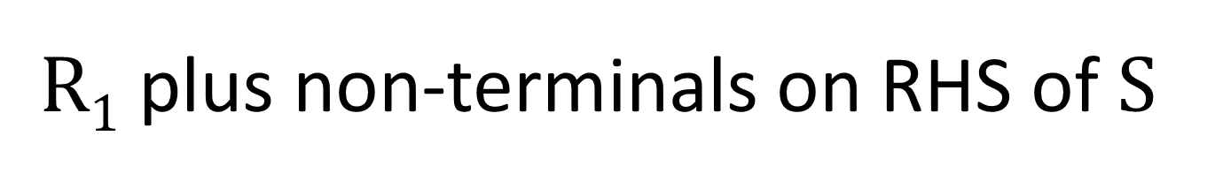
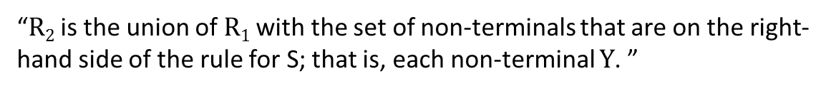
$R1$ plus non-terminals on RHS of S
R₂ is a set consisting of the start symbol plus all the non-terminals that can be directly reached from the start symbol. This is expressed formally as
R₂ = R₁ ∪ {Y | S → $UY$W ∈ F for some U, W ∈ (V_{N} ∪ V_{T})* $and Y ∈ VN$}
“R₂ is the union of R₁ with the set of non-terminals that are on the right-hand side of the rule for S; that is, each non-terminal $Y$. ”

Slide 67
Non-terminals on RHS of S
{A, B} ← Add these to {S}
S → A B
A → a
B → b C
C → c
E → e

Slide 68
Merge (union) sets
{ S } { A, B }
R₂ = { A, B, S }

Slide 69
R₂ plus its non-terminals
R₃ consists of the symbols in R₂ plus all the non-terminals that can be directly reached from the symbols in R₂. This is expressed formally as
R₃ = R₂ ∪ {Y | X → $UY$W ∈ F for some X ∈ R₂ and U, W ∈ (V_{N} ∪ V_{T})* $and Y ∈ VN$}
“R₃ is the union of R₂ with the non-terminals that are on the right-hand side of X, where X is a non-terminal in R₂. ”

Slide 70
Add non-terminals on RHS of non-terminals in R₂
S → A B
A → a
B → b C
C → c
E → e
Add {C} to R₂
R₂ = { A, B, S }

Slide 71
Merge (union) sets
{ A, B, S } { C }
R₃ = { A, B, C, S }

Slide 72
Add non-terminals on RHS of non-terminals in R₃
S → A B
A → a
B → b C
C → c
E → e
R₃ = { A, B, C, S }
No additional non-terminals to add!

Slide 73
We have the set of reachable non-terminals
S → A B
A → a
B → b C
C → c
E → e
R₃ = { A, B, C, S }
These are the reachable non-terminals in this grammar. So, the rule E → e can be removed.

Slide 74
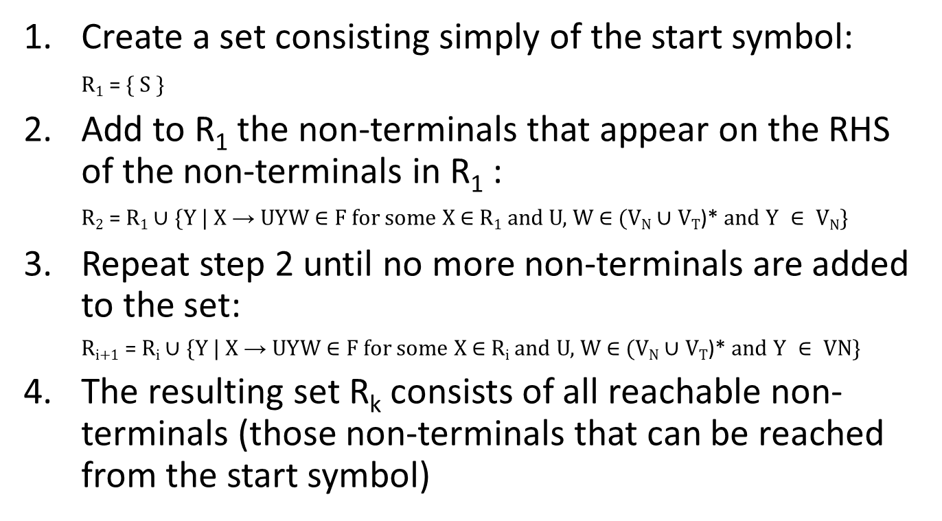
Formal algorithm for finding reachable non-terminals
Create a set consisting simply of the start symbol:
R₁ = { S }
Add to R₁ the non-terminals that appear on the RHS of the non-terminals in R₁ :
R₂ = R₁ ∪ {Y | X → $UY$W ∈ F for some X ∈ R₁ and U, W ∈ (V_{N} ∪ V_{T})* $and Y ∈ VN$}
Repeat step 2 until no more non-terminals are added to the set:
R_{i+1} = R_{i} ∪ {Y | X → $UY$W ∈ F for some X ∈ R_{i} and U, W ∈ (V_{N} ∪ V_{T})* $and Y ∈ VN$}
The resulting set R_{k} consists of all reachable non-terminals (those non-terminals that can be reached from the start symbol)

Slide 75
Non-redundant grammar
Remove all the unproductive non-terminals.
From the resulting grammar, remove all the unreachable non-terminals.
The result is a non-redundant grammar.
A non-redundant grammar is one where each non-terminal is both productive and reachable. It is also known as a reduced grammar.

