Slide 1
Using Alloy to Design a Safe Traffic Light System
Roger L. Costello
December 1, 2016

Slide 2
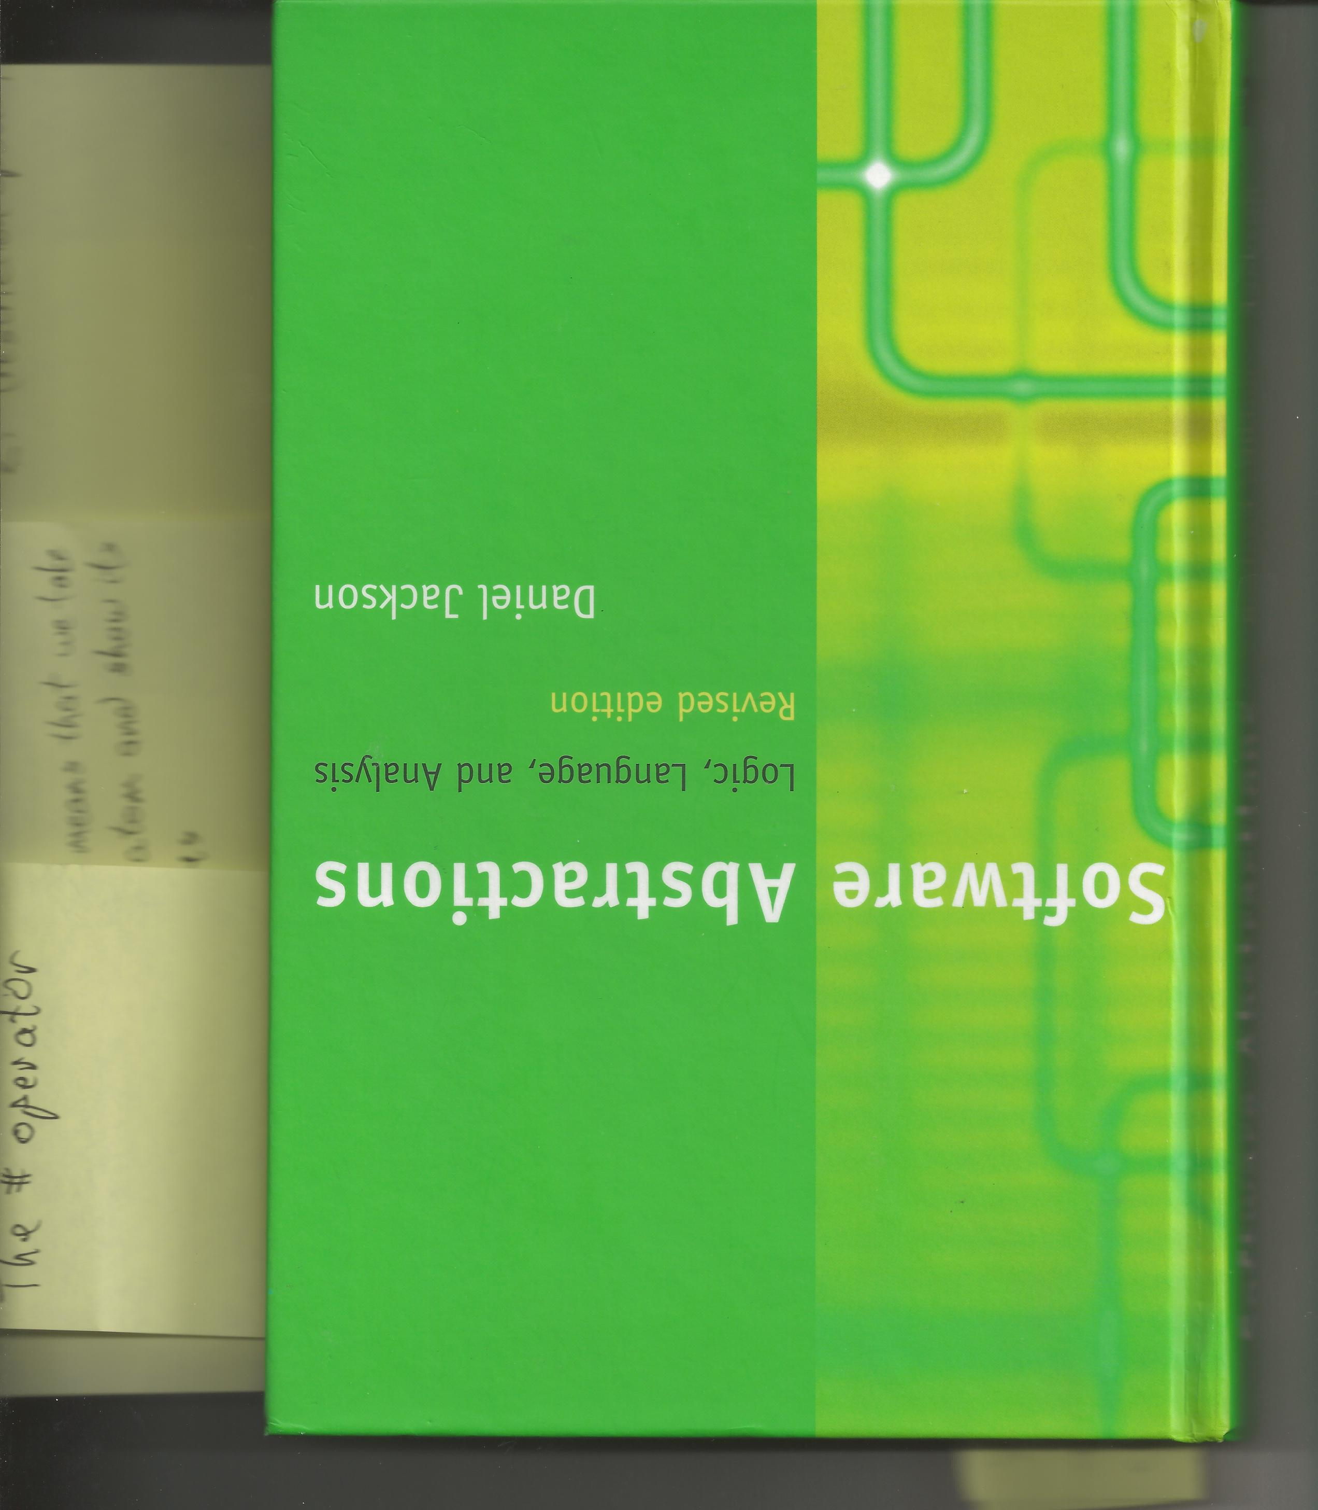
Acknowledgement
The traffic light model shown in these slides comes from this (fantastic) book, page 129.

Slide 3
Traffic lights control the flow of vehicles
Traffic lights guard the vehicles passing through.
For a safe system, the traffic lights must not allow vehicles from perpendicular directions to pass through the junction at the same time.

Slide 4

We will create a model of traffic lights

Slide 5
Light
Light

Slide 6
Junction

Slide 7
“Light State” is the state of the lights. The Light State at this junction: this light is red, that light is green.

Slide 8
What “safety requirement” do we desire for the lights?

Slide 9
What “safety requirement” do we desire for the lights?
Answer: at no time are the lights for perpendicular directions green.

Slide 10
3 things needed for a safe flow of traffic at a junction:
Only one light changes at a time.
Each light must follow the proper color change sequence, e.g., red to green to yellow to red.
If a light changes from red to non-red, then all the other lights must be red.

Slide 11
Recap
Model the traffic lights at each junction.
The model must implement the safety requirement.

Slide 12
Step 1: Define the components
The components of the traffic light system are:
The lights
The junctions and the lights at each junction
The light colors (red, green, yellow)
The light states (i.e., the color of each light at each junction)

Slide 13
Model the junctions
Junction
5th & Elm
6th & Elm
7th & Elm
…
Alloy code:
sig Junction {}

Slide 14
This is the 5th & Elm junction
Light L1
Light L2

Slide 15
Simple identifiers, for illustrative purposes
In these slides the traffic lights are identified by L1, L2, etc.
In reality a more complicated identifier would be used to identify a light, perhaps its model number.

Slide 16
Model the lights
Light
L1
2 lights at 5th & Elm
L2
L3
2 lights at 6th & Elm
L4
L5
2 lights at 7th & Elm
L6
…
Alloy code:
sig Light {}

Slide 17
Model the lights at each junction
Junction
Light
lights
5th & Elm
L1
5th & Elm
L1
6th & Elm
L2
5th & Elm
L2
7th & Elm
L3
6th & Elm
L3
L4
6th & Elm
L4
L5
7th & Elm
L5
L6
7th & Elm
L6
Lights at each junction
Alloy code:
sig Junction {lights: set Light}

Slide 18
Model the colors displayed by the traffic lights
Color
Green
Red
Yellow
Alloy code:
abstract sig Color {}
one sig Red, Yellow, Green extends Color {}

Slide 19
Model the state of the lights
LightState
state1
state2
…
Alloy code:
sig LightState {}

Slide 20
For example, “state1” could denote the traffic lights having these colors
L1
L2
L3
L4
L5
L6
At 5th & Elm light L1 is red, light L2 is green
At 6th & Elm light L3 is green, light L4 is red
At 7th & Elm light L5 is green, light L6 is yellow

Slide 21
Model the color displayed by each light, for all states
LightState
Light
Color
color
state1
L1
red
state1
L1
red
state2
L2
yellow
state1
L2
green
L3
green
state1
L3
green
L4
state1
L4
red
L5
state1
L5
green
L6
state1
L6
yellow
state2
L1
green
state2
L2
yellow
Alloy code:
state2
L3
yellow
sig LightState {
color: Light -> one Color
}
state2
L4
green
state2
L5
yellow
state2
L6
red

Slide 22
Recap: here’s the traffic lights model
abstract sig Color {}
one sig Red, Yellow, Green extends Color {}
sig Light {}
sig Junction {
lights: set Light
}
sig LightState {
color: Light -> one Color
}

Slide 23
Step 1: Define the components
The components of the traffic light system are:
The lights
The junctions and the lights at each junction
The light colors (red, green, yellow)
The light states (the color of each light at each junction)
Accomplished

Slide 24
Step 2: Constrain the transitions of the lights
For the lights at a junction:
For the light change (transition):
A light’s color changes must follow the proper sequence.
At most one light can change at a time.
If the light that changed is red, then the other lights must be red.

Slide 25
For the lights at a junction:
For the light change:
A light’s color changes must follow the proper sequence.
At most one light can change.
If the light that changed is red, then the other lights must be red.
Let’s first implement this constraint.

Slide 26


Example of a valid and invalid light sequence
A traffic light can change from red to green, but not from red to yellow.

Slide 27
The set of valid light sequences

Slide 28
No change in color, i.e., identity mappings. The next few slides show a really neat way to generate these identity mappings.

Slide 29
Here’s our universe
univ
L1
L2
L3
Light
L4
L5
L6
state1
LightState
state2
red
yellow
Color
green
5th & Elm
6th & Elm
Junction
7th & Elm

Slide 30
Identity mappings
iden
L1
L1
L2
L2
L3
L3
L4
L4
L5
L5
L6
L6
state1
state1
state2
state2
red
red
yellow
yellow
green
green
5th & Elm
5th & Elm
6th & Elm
6th & Elm
7th & Elm
7th & Elm

Slide 31
“Restriction operator.” It says: give me all the color mappings in iden.
iden
L1
L1
Color
L2
L2
Color <: iden
red
red
red
L3
L3
yellow
yellow
yellow
L4
L4
green
green
green
L5
L5
L6
L6
Color identity mappings
state1
state1
state2
state2
red
red
yellow
yellow
green
green
5th & Elm
5th & Elm
6th & Elm
6th & Elm
7th & Elm
7th & Elm

Slide 32
The set of valid traffic light color sequences
Red -> green +
Green -> yellow +
Yellow -> red +
Red -> red
Green -> green
Yellow -> yellow
Color <: iden

Slide 33
Here’s an Alloy function that returns the valid color sequences
fun colorSequence: Color -> Color {
(Color <: iden) + (Red -> Green) + (Green -> Yellow) + (Yellow -> Red)
}
colorSequence returns this mapping:
red
red
yellow
yellow
green
green
red
green
green
yellow
yellow
red

Slide 34
For the lights at a junction:
For the light change:
A light’s color changes must follow the proper sequence.
At most one light can change.
If the light that changed is red, then the other lights must be red.
Now let’s implement this constraint.

Slide 35
Here’s how to get the lights at junction j
j: Junction
lights
x
5th & Elm
5th & Elm
L1
x: j.lights
L1
5th & Elm
L2
L2
6th & Elm
L3
x denotes the lights at 5th & Elm
6th & Elm
L4
7th & Elm
L5
7th & Elm
L6

Slide 36
Here’s how to get the colors of the lights at 5th & Elm, in state1
x
s: LightState
color
L1
state1
state1
L1
red
x.(s.color)
L2
state1
L2
green
state1
L3
green
state1
L4
red
red
state1
L5
green
green
state1
L6
yellow
state2
L1
red
state2
L2
yellow
state2
L3
yellow
state2
L4
red
state2
L5
green
state2
L6
red

Slide 37
Equivalent
x.(s.color)
s.color[x]

Slide 38
Here’s how to get the colors of the lights at 5th & Elm, in state2
color
state1
L1
red
state1
L2
green
state1
L3
green
state1
L4
red
state1
L5
green
x
s: LightState
state1
L6
yellow
L1
state2
state2
L1
red
s.color[x]
L2
state2
L2
yellow
state2
L3
yellow
state2
L4
red
red
state2
L5
green
yellow
state2
L6
red

Slide 39
Light changes at 5th & Elm between state1 and state2
red
red
green
yellow
state1
state2
Only one light changed from state1 to state 2.

Slide 40
Alloy code that expresses: At most one light changes color from state s to state s’
pred at_most_one_light_changes_color (s, s': LightState, j: Junction) {
lone x: j.lights | s.color[x] != s'.color[x]
}

Slide 41
For the lights at a junction:
For the light change:
A light’s color changes must follow the proper sequence.
At most one light can change.
If the light that changed is red, then the other lights must be red.
Implemented

Slide 42
Consider the lights at a junction:
Consider a light change:
A light’s color changes must follow the proper sequence.
At most one light can change.
If the light that changed is red, then the other lights must be red.
Now let’s implement this constraint.

Slide 43
Let s be the current state of the traffic lights. Then s’ is a valid next state for the traffic lights at junction j if:
At most one light changes between s and s’.
For each light x at junction j:
The mapping from the color of x in state s to the color of x in state s’ is part of the color sequence.
If x changes color from red to non-red, then all the lights at junction j, in state s, must be red.

Slide 44
pred transition (s, s': LightState, j: Junction) {
At most one light changes between s and s’.
For each light x at junction j:
The mapping from the color of x in state s to the color of x in state s’ is part of the color sequence.
If x changes color from red to non-red, then all the lights at junction j, in state s, must be red.
}

Slide 45
lone x: j.lights | s.color[x] != s'.color[x]
pred transition (s, s': LightState, j: Junction) {
At most one light changes between s and s’.
For each light x at junction j:
The mapping from the color of x in state s to the color of x in state s’ is part of the color sequence.
If x changes color from red to non-red, then all the lights at junction j, in state s, must be red.
}

Slide 46
pred transition (s, s': LightState, j: Junction) {
lone x: j.lights | s.color[x] != s'.color[x]
For each light x at junction j:
The mapping from the color of x in state s to the color of x in state s’ is part of the color sequence.
If x changes color from red to non-red, then all the lights at junction j, in state s, must be red.
}
all x: j.lights

Slide 47
s.color[x]
pred transition (s, s': LightState, j: Junction) {
lone x: j.lights | s.color[x] != s'.color[x]
all x: j.lights |
The mapping from the color of x in state s to the color of x in state s’ is part of the color sequence.
If x changes color from red to non-red, then all the lights at junction j, in state s, must be red.
}
colorSequence
s'.color[x]

Slide 48
let step = s.color[x] -> s'.color[x]
step in colorSequence
pred transition (s, s': LightState, j: Junction) {
lone x: j.lights | s.color[x] != s'.color[x]
all x: j.lights |
The mapping from the color of x in state s to the color of x in state s’ is part of the color sequence.
If x changes color from red to non-red, then all the lights at junction j, in state s, must be red.
}

Slide 49
pred transition (s, s': LightState, j: Junction) {
lone x: j.lights | s.color[x] != s'.color[x]
all x: j.lights |
let step = s.color[x] -> s'.color[x]
step in colorSequence
If x changes color from red to non- red, then all the lights at junction j, in state s, must be red.
}
Red -> (Color - Red)
j.lights

Slide 50
pred transition (s, s': LightState, j: Junction) {
lone x: j.lights | s.color[x] != s'.color[x]
all x: j.lights |
let step = s.color[x] -> s'.color[x]
step in colorSequence
If x changes color from red to non- red, then all the lights at junction j, in state s, must be red.
}
step in Red -> (Color - Red) => j.lights in redLights[s]

Slide 51
pred transition (s, s': LightState, j: Junction) {
lone x: j.lights | s.color[x] != s'.color[x]
all x: j.lights |
let step = s.color[x] -> s'.color[x] {
step in colorSequence
step in Red -> (Color - Red) => j.lights in redLights[s]
}
}

Slide 52
This predicate only requires instances contain a junction j and a pair of states s and s’ that satisfy the constraints. But we want all junctions and all pairs of states to satisfy the constraints.
pred transition (s, s': LightState, j: Junction) {
lone x: j.lights | s.color[x] != s'.color[x]
all x: j.lights |
let step = s.color[x] -> s'.color[x] {
step in colorSequence
step in Red -> (Color - Red) => j.lights in redLights[s]
}
}

Slide 53
Also notice that this predicate assumes nothing about the current state s. So all the lights at junction j in state s could be green! We need to constrain s to those states where all lights are red except at most one.
pred transition (s, s': LightState, j: Junction) {
lone x: j.lights | s.color[x] != s'.color[x]
all x: j.lights |
let step = s.color[x] -> s'.color[x] {
step in colorSequence
step in Red -> (Color - Red) => j.lights in redLights[s]
}
}

Slide 54
assert SafeTrafficLights {
all s, s': LightState, j: Junction |
all_lights_red_except_at_most_one_light [s, j] and transition [s, s', j] => all_lights_red_except_at_most_one_light [s', j]
}
Assertion: every junction and every light transition is safe.

Slide 55
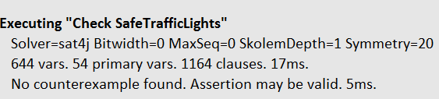
Yea!

Slide 56
abstract sig Color {}
one sig Red, Yellow, Green extends Color {}
sig Light {}
sig Junction {
lights: set Light
}
sig LightState {
color: Light -> one Color
}
fun colorSequence: Color -> Color {
(Color <: iden) + (Red -> Green) + (Green -> Yellow) + (Yellow -> Red)
}
fun redLights (s: LightState): set Light {
s.color.Red
}
pred all_lights_red_except_at_most_one_light (s: LightState, j: Junction) {
lone j.lights - redLights[s]
}
pred transition (s, s': LightState, j: Junction) {
lone x: j.lights | s.color[x] != s'.color[x]
all x: j.lights |
let step = s.color[x] -> s'.color[x] {
step in colorSequence
step in Red -> (Color - Red) => j.lights in redLights[s]
}
}
assert SafeTrafficLights {
all s, s': LightState, j: Junction |
all_lights_red_except_at_most_one_light [s, j] and transition [s, s', j] => all_lights_red_except_at_most_one_light[s', j]
}
check SafeTrafficLights
Here’s the complete Alloy code:

Slide 57
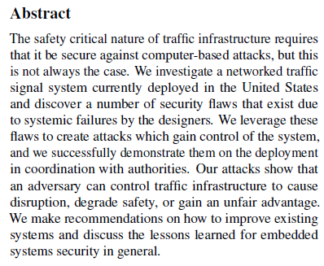
Extend the traffic model to ensure against security flaws
https://jhalderm.com/pub/papers/traffic-woot14.pdf

