Slide 1
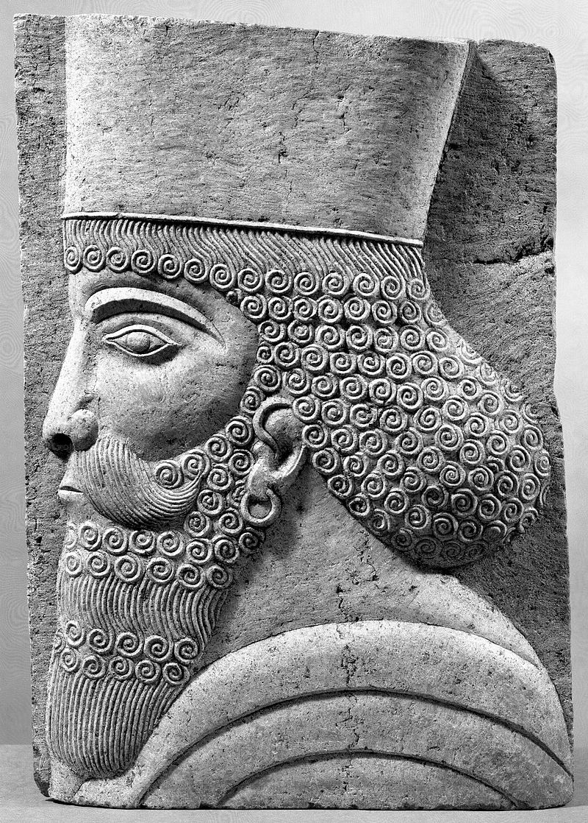
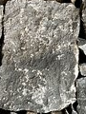
Sculpting Alloy Models
constraints
Roger L. Costello
January 19, 2017

Slide 2
An Alloy modeler is like a sculptor
A sculptor starts with a raw chunk of stone and chips away at it until the desired sculptor is achieved.
Similarly, an Alloy modeler starts with a raw universe of relations and constrains it until the desired model is achieved

Slide 3
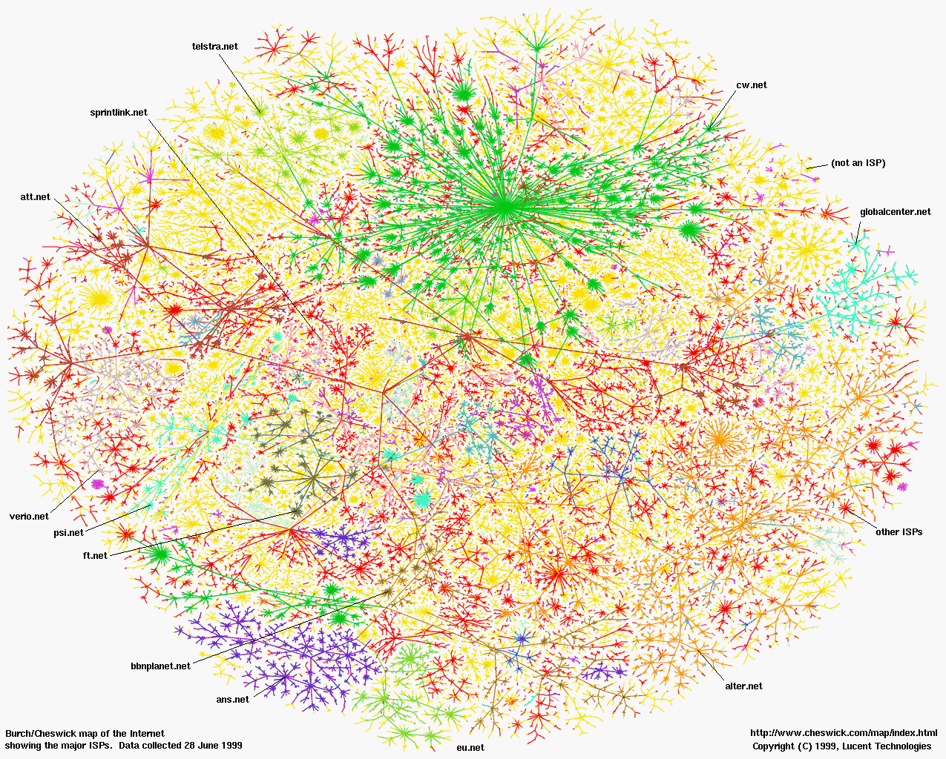
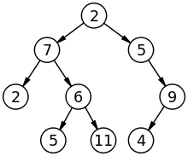
Infinite Universe of Relations
Apply constraints to achieve tree data structures
constraints

Slide 4
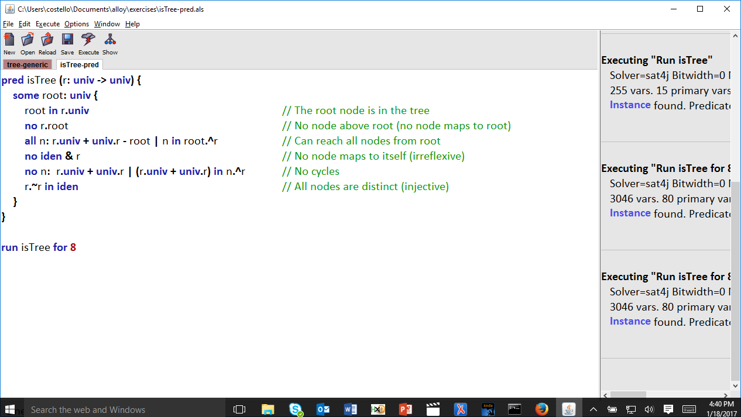
Start with an infinite universe of pairs of values. (Analogous to starting with a raw chunk of stone)

Slide 5
Apply appropriate constraints.
(Analogous to chipping away at the stone)

Slide 6
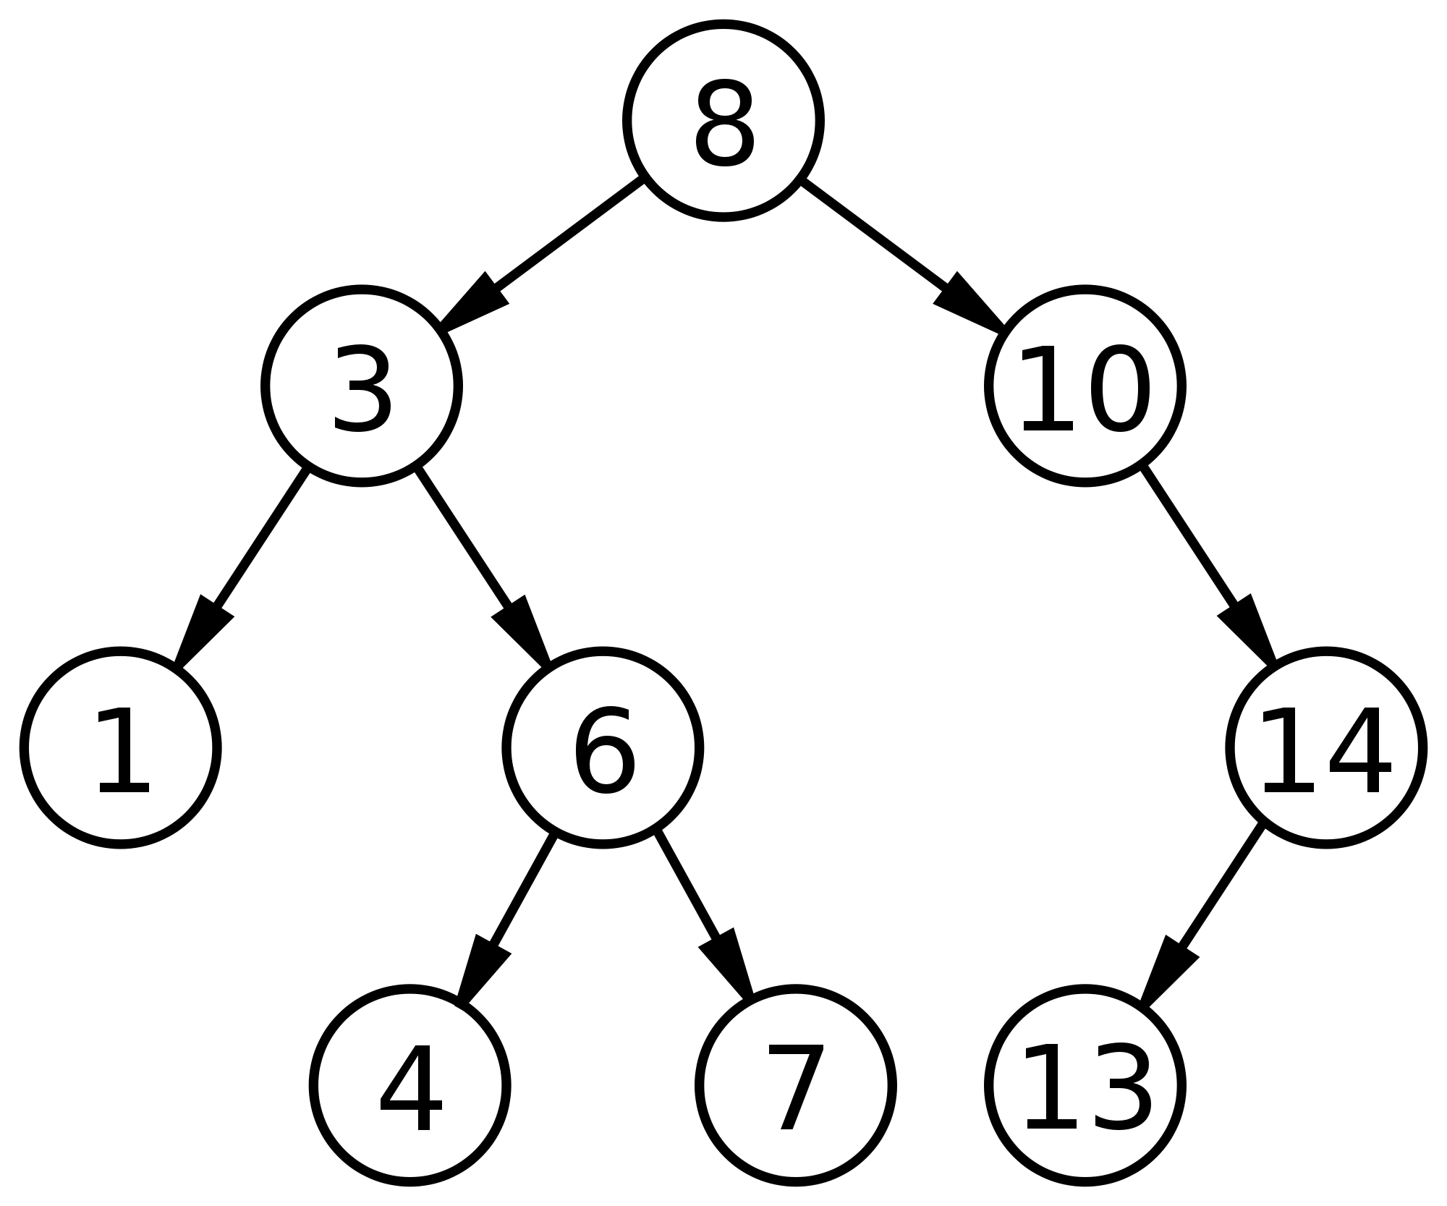
The universe of pairs has been constrained to tree data structures.
Magnificent!

