Slide 1
Using Alloy to model the self-selection of a leader in a decentralized set of communicating processes
I’m the leader!
time …
Roger L. Costello
December 18, 2016

Slide 2
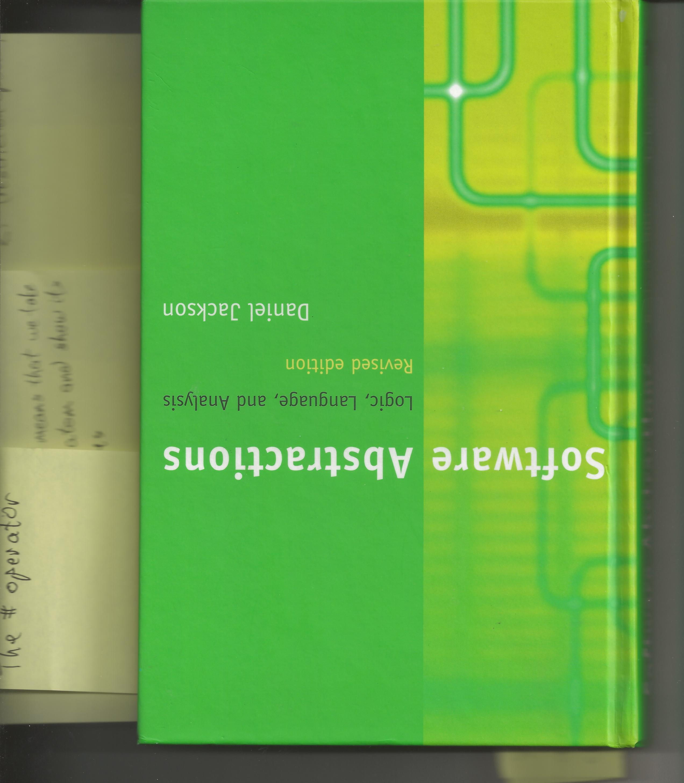
Acknowledgement
The decentralized-elect-a-leader model shown in these slides comes from this (fantastic) book, pages 171-187.

Slide 3
First, a few words about the
“thinking declaratively”

Slide 4
Key skill
A key skill for modeling (both data modeling and software modeling) is the ability to think and express declaratively.
The next few slides show two problems and their declarative expressions.

Slide 5
Declaratively express this constraint:
  A set of nodes must form ring (cyclic) topology.
node4
node3
node5
node2
node6
node1
node7
node0
Assume each node has a succ field, identifying its neighbor. How would you declaratively constrain the nodes to a ring topology?

Slide 6
Here is a declarative description of constraining nodes to form a ring topology :
All nodes must be reachable from any node
by following succ repeatedly.

Slide 7
Here is how the constraint is expressed in the Alloy modeling language :
all n: Node | Node in n.^succ
For each Node n, the entire set of nodes must be in the set of nodes reachable by n.
The caret symbol denotes the set of nodes reachable from n.

Slide 8
Give a set of nodes, plus the above constraint expression, to the Alloy Analyzer and the Analyzer will decide if the nodes satisfy the constraint (i.e., the Analyzer will tell you if the nodes are in a ring structure).

Slide 9
Remove one item from a pile
A
B
C
B
C
B
C
D
B
C
D
Pile (before)
Pile (after)
How would you declaratively express the change in the pile?

Slide 10
Here is a declarative description of the change in the pile :
The pile after is equal to the pile before,
minus one item.

Slide 11
Here is how the constraint is expressed using the Alloy language:
before, after: Time | pile.after = pile.before - item
Important: This expression is not a recipe/algorithm/procedure for how to remove an item from the pile. Rather, it is a description of the pile after by comparing it to the pile before.

Slide 12
Now, back to modeling the leader election

Slide 13
Elect a leader on the fly
Many distributed protocols require one process to play the role of a leader, coordinating the others.
Assigning the leader in advance is not feasible, so some mechanism is needed by which a collection of communicating processes can “elect” a leader on the fly.

Slide 14
Collection of communicating processes elects a leader
P4
P3
P5
Assumptions that our model will make:
The processes form a ring.
The processes have unique identifiers that are totally ordered (P0, P1, …).
The leader will be the process with the largest identifier.
P2
P6
P1
P7
P0

Slide 15
We will create a model of this distributed algorithm (i.e., protocol)
The processes pass their identifiers as tokens around the ring in some direction (say clockwise).
Each process examines the identifier it receives and decides:
  If the identifier is less than its own identifier, it consumes the token (i.e., the token is dropped).
  If the identifier is greater than its own, it passes the token on.
  If the identifier equals its own identifier, it knows the token must have passed all the way around the ring, so it elects itself the leader.

Slide 16
Purpose of the protocol
The purpose of the protocol is to reach a state in which exactly one leader is elected.

Slide 17
After creating the model, check that these properties hold
At most one leader gets elected.
Some leader is eventually elected.
Alloy
Analyzer
Hey Alloy Analyzer, will a leader get elected?
Model

Slide 18
Derive requirements from the real world
In the real world processes run concurrently, so the model must support all interleavings of process execution.
In the real world messages are buffered, reordered, and even dropped, so the model must support these things.
concurrency
messages out-of-order
unreliable delivery (messages dropped)

Slide 19
How we will model the real world
Real world
Alloy model
Message buffers between the processes
Messages might get out of order (i.e., reordered)
Processes run concurrently.
Messages might get dropped.
Each process has a pool of tokens. In one step, a token can be taken from the pool of one process and moved to the pool of its successor in the ring.
We’ll make arbitrary the selection of the token.
We’ll make arbitrary the selection of which processes are involved in a given step.
Message delivery will be reliable. (We won’t model unreliable delivery, although we easily could).

Slide 20

“Time” and “Process” are ordered sets
Time
Process
T0
P0
T1
P1
T2
P2
…
…

Slide 21
Alloy code:
open util/ordering[Time]
open util/ordering[Process]
sig Time {}
sig Process {}
Use the Alloy ordering utility

Slide 22
Ordered sets inherit several fields
Let t: Time and p: Process
  t.next means the next time value
  t.first means the first time value
  p.prevs means the set of all processes preceding p in the ordering
  t.prev means the direct predecessor of t in the ordering
  all t: Time - first means all times after T0

Slide 23
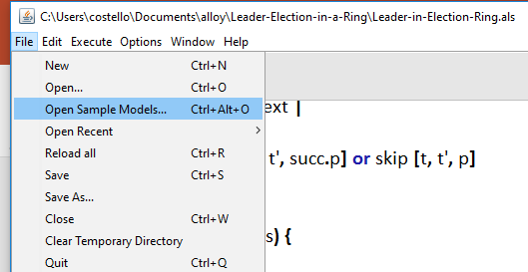
More info on the Alloy utility modules
In the Alloy tool, select File >> Open Sample Models and you can see all the utility modules listed with comments explaining each.
select this

Slide 24
Process
P0
P1
process identifiers (a.k.a. tokens)
P2
…

Slide 25
Each process has a neighbor (successor)
Process
Process
succ
P0
P0
P0
P1
P1
P1
P1
P2
P2
P2
P2
P3
P3
P3
P3
P4
P4
P4
P4
P5
P5
P5
P5
P6
P6
P6
P6
P7
P7
P7
P7
P0
Successor of P0 is P1.
Successor of P1 is P2.
…

Slide 26
Alloy code:
sig Process {succ: Process}

Slide 27
Constrain the processes to a ring (cyclic)
P4
P3
P5
P2
P6
P1
P7
P0

Slide 28
Here’s how to constrain the processes to form a ring
Alloy code:
fact Ring {all p: Process | Process in p.^succ}
For each process p, the entire set of processes must be in the set of processes reachable by p.
The caret symbol denotes the set of processes reachable from p.

Slide 29
The topology is static
sig Process {succ: Process}
Notice that Time doesn’t appear in the declaration of the succ field, which means the topology of the processes is static.

Slide 30
Each process has a pool of identifiers
In the real world, processes don’t necessarily operate at the same speed.
A process might operate faster than its successor, so it’s successor must be able to deal with a pool of process identifiers.
pool of process identifiers
pool of process identifiers
p
q

Slide 31
Associate each process identifier with time
A process receives identifiers at different times, so each process identifier in the pool needs to be associated with a time.
At time T0, process identifier p is in the pool. At time T1, process identifier … is in the pool.
T0:
p
T0:
q
T1:
…
T1:
…
p
q

Slide 32
This pool contains the set of process identifiers that process p must examine and, when appropriate, send to process q.
T0:
p
T0:
q
T1:
…
T1:
…
p
q

Slide 33
Process
Process
Time
toSend
P0
P0
T0
P0
P0
T0
P1
P1
T1
P1
P1
T0
P2
P2
T2
…
…
…
P3
P3
P4
P4
At time T0 process P0 has P0 in its pool.
At time T0 process P1 has P1 in its pool.
P5
P5
P6
P6
P7
P7

Slide 34
Alloy code:
sig Process {
succ: Process,
toSend: Process -> Time
}

Slide 35
toSend
…
…
…
p
q
t
…
…
…
Process p holds the identifier of process q in its pool at time t.

Slide 36
Process
Time
elected
P7
T0
P7
T7
…
T1
…
…
T2
…
At time T7 process P7 is elected the leader.

Slide 37
Alloy code:
sig Process {
succ: Process,
toSend: Process -> Time,
elected: set Time
}

Slide 38
Protocol (revisited)
Init: (T0) each process stores its identifier in its pool.
Step: process p removes an arbitrary identifier id from its pool and places id into p.succ’s pool if id is greater than the successor process’s identifier; if the id is less than the successor process’s identifier, then the id is dropped.
Elect Leader: (after T0) process p is elected the leader if it just received its identifier. (We will revise this a bit later.)

Slide 39
Initial condition (T0)
In the beginning, each process hasn’t received any tokens.
Store in each process’s pool its own identifier.

Slide 40
Init (Time = T0)
T0:
P4
T0:
P5
P4
T0:
P3
P3
P5
P2
P6
T0:
T0:
P6
P2
P1
P7
P0
T0:
T0:
P7
P1
T0:
P0

Slide 41
pred init (t: Time) {
all p: Process | p.toSend.t = p
}
init [T0]

Slide 42
Process
Process
Time
toSend
P0
P0
T0
P0
P0
T0
P1
P1
P1
P1
T0
P2
P2
P2
P2
T0
P3
P3
P3
P3
T0
P4
P4
P4
P4
T0
P5
P5
P5
P5
T0
P6
P6
P6
P6
T0
P7
P7
P7
P7
T0
For each process its pool is initialized to itself at the first time value.

Slide 43
Step (Time > 0)
Select an arbitrary process identifier (selecting an “arbitrary process identifier” models messages getting out of order).
t:
a,b,c
p
b
t:
x,y,z
q
Continued →

Slide 44
t:
a,b,c
t':
a,c
At the next time (t') the process identifiers in p’s pool are those at time t, minus the process identifier that was selected (b).
p
b
t:
x,y,z
q
Continued →

Slide 45
t:
a,b,c
t':
a,c
p
b
t:
x,y,z
t':
b,x,y,z
At the next time (t') the process identifiers in q’s pool are those at time t, plus the received process identifier (b).
q
Continued →

Slide 46
t:
a,b,c
t':
a,c
p
b
t:
x,y,z
t':
b,x,y,z
q
This goes into q’s pool only if it is greater than or equal to q (recall that a process will drop identifiers it receives which are less than its own identifier).

Slide 47
pred step (t, t': Time, p: Process) {
let from = p.toSend, to = p.succ.toSend |
some id: from.t {
from.t' = from.t - id
to.t' = to.t + (id - p.succ.prevs)
}
}

Slide 48
p’s pool
pred step (t, t': Time, p: Process) {
let from = p.toSend, to = p.succ.toSend |
some id: from.t {
from.t' = from.t - id
to.t' = to.t + (id - p.succ.prevs)
}
}

Slide 49
q’s pool
pred step (t, t': Time, p: Process) {
let from = p.toSend, to = p.succ.toSend |
some id: from.t {
from.t' = from.t - id
to.t' = to.t + (id - p.succ.prevs)
}
}

Slide 50
Select an arbitrary process identifier from p’s pool at time t.
pred step (t, t': Time, p: Process) {
let from = p.toSend, to = p.succ.toSend |
some id: from.t {
from.t' = from.t - id
to.t' = to.t + (id - p.succ.prevs)
}
}

Slide 51
p’s pool at time t' is equal to its pool at time t minus the selected process identifier
pred step (t, t': Time, p: Process) {
let from = p.toSend, to = p.succ.toSend |
some id: from.t {
from.t' = from.t - id
to.t' = to.t + (id - p.succ.prevs)
}
}

Slide 52
q’s pool at time t’ is equal to its pool at time t plus the selected process identifier, unless the identifier is less than q.
pred step (t, t': Time, p: Process) {
let from = p.toSend, to = p.succ.toSend |
some id: from.t {
from.t' = from.t - id
to.t' = to.t + (id - p.succ.prevs)
}
}

Slide 53

t:
P3,P5,P7
t':
P5,P7
P3
P3
t:
P6
t':
P6
P4
Identifier P3 is not put into P4’s pool because P3 < P4.

Slide 54
Step: process p removes an arbitrary identifier id from its pool and places id into p.succ’s pool if id is greater than the successor process’s identifier; if the id is less than the successor process’s identifier, then the id is dropped.
pred step (t, t': Time, p: Process) {
let from = p.toSend, to = p.succ.toSend |
some id: from.t {
from.t' = from.t - id
to.t' = to.t + (id - p.succ.prevs)
}
}

Slide 55
Key point
pred step (t, t': Time, p: Process) {
let from = p.toSend, to = p.succ.toSend |
some id: from.t {
from.t' = from.t - id
to.t' = to.t + (id - p.succ.prevs)
}
}
This does not mean that an identifier is taken from p’s pool. Rather, it means that p’s pool at time t’ is the same as its pool at time t, minus the identifier that was selected. It is a declarative description of p’s pool at time t and t’. It is not a procedural description of how to remove an identifier from p’s pool and insert it into its successor’s pool.

Slide 56
Elected
When is a process elected?
The next few slides answer this question.
We’ll examine a ring containing 3 processes.

Slide 57
Here’s how processes behave during each time step
At each time step each process does one of three things:
  It does a step – selects and transfers an id to its successor
  It does nothing because its predecessor does a step
  It does a skip - copies its pool from the previous time step to this time.

Slide 58
Here’s how each process behaves over a series of time steps
At each time step each process does one of three things:
  It does a step - transfers an id to its successor
  It does nothing - because its predecessor does a step
  It does a skip - copies its pool from the previous time to this time.
pred skip (t, t': Time, p: Process) {
p.toSend.t' = p.toSend.t
}
Process p’s pool is the same at Time t' as it was at Time t.

Slide 59
Time T0
T0:
P0
P0
T0:
P2
T0:
P1
P2
P1

Slide 60
Time T0 to T1
T0:
P0
T1:
P0,P2
P2
P0
skip
T0:
P2
T1:
ε
T0:
P1
T1:
P1
P2
P1

Slide 61
Time T1 to T2
T0:
P0
T1:
P0, P2
T2:
P0
P2
skip
P0
T0:
P2
T0:
P1
T1:
ε
T1:
P1
T2:
ε
T2:
P1,P2
P2
P1

Slide 62
Time T2 to T3
skip
T0:
P0
T1:
P0, P2
T2:
P0
T3:
P0
P0
T0:
P2
T0:
T1:
ε
P1
T2:
T1:
P1
ε
T2:
T3:
P2
P1, P2
T2:
P1
P2
P1
P2

Slide 63
Time T3
T0:
P0
T1:
P0, P2
T2:
P0
T3:
P0
P0
T0:
P2
T0:
T1:
ε
P1
T2:
T1:
P1
ε
T2:
I’m the leader!
T3:
P2
P1, P2
T2:
P1
P2
P1

Slide 64
The “execution trace” shown on the last 5 slides is neat! Let’s go through it again, but with more explanation.

Slide 65
Time T0
pred init (t: Time) {
all p: Process | p.toSend.t = p
}
T0:
P0
fact Traces {
init [T0]
}
P0
T0:
P2
T0:
P1
P2
P1
At time T0 each process’s pool is initialized to its own identifier.

Slide 66
Time T0 to T1
pred step (t, t': Time, p: Process) {
let from = p.toSend, to = p.succ.toSend |
some id: from.t {
from.t' = from.t - id
to.t' = to.t + (id - p.succ.prevs)
}
}
T0:
P0
T1:
P0,P2
P2
Step – move P2 into the P0’s pool. Copy P0’s pool from time T0 into time T1. Copy P2’s pool from time T0 into time T1, except for P2; thus, P2 has nothing in its pool at time T1 (ε denotes the empty set).
pred skip (t, t': Time, p: Process) {
p.toSend.t' = p.toSend.t
}
P0
skip
T0:
P2
T1:
ε
T0:
P1
T1:
P1
P2
P1
Skip – copy the pool from the time T0 into time T1.

Slide 67
Time T1 to T2
pred step (t, t': Time, p: Process) {
let from = p.toSend, to = p.succ.toSend |
some id: from.t {
from.t' = from.t - id
to.t' = to.t + (id - p.succ.prevs)
}
}
T0:
P0
T1:
P0, P2
pred skip (t, t': Time, p: Process) {
p.toSend.t' = p.toSend.t
}
T2:
P0
P2
Step – move P2 into the P1’s pool. Copy P1’s pool from time T1 into time T2. Copy P0’s pool from time T1 into time T2, except for P2.
Skip – copy the pool from time T1 into time T2. Since there is nothing in the pool at T1, there is also nothing in the pool at T2.
skip
P0
T0:
P2
T0:
P1
T1:
ε
T1:
P1
T2:
ε
T2:
P1,P2
P2
P1

Slide 68
Time T2 to T3
skip
pred skip (t, t': Time, p: Process) {
p.toSend.t' = p.toSend.t
}
T0:
P0
T1:
P0, P2
Skip – copy the pool from the time T2 into time T3.
T2:
P0
T3:
P0
Step – move P2 into the P2’s pool. Copy P2’s pool from time T2 into time T3 (nothing to copy). Copy P1’s pool from time T2 into time T3, except for P2.
P0
T0:
P2
T0:
T1:
ε
P1
T2:
T1:
P1
ε
T2:
T3:
P2
P1, P2
T2:
P1
P2
P1
pred step (t, t': Time, p: Process) {
let from = p.toSend, to = p.succ.toSend |
some id: from.t {
from.t' = from.t - id
to.t' = to.t + (id - p.succ.prevs)
}
}
P2

Slide 69
Time T3
T0:
P0
T1:
P0, P2
T2:
P0
T3:
P0
P0
T0:
P2
T0:
T1:
ε
P1
T2:
T1:
P1
ε
T2:
I’m the leader!
T3:
P2
P1, P2
T2:
P1
P2
P1

Slide 70
Rules for electing a leader
At time=0 (i.e., Init), no process is a leader.
At time=t (t > 0), process p is a leader if it’s identifier is in its pool at time t and it’s not in its pool at time t-1.
T0:
P2
T1:
ε
T2:
ε
At time T3 process P2 has its identifier in its pool and it’s not in its pool at the previous time, T2.
I’m the leader!
T3:
P2
P2

Slide 71
fact DefineElected {
no elected.first
all t: Time - first |
elected.t = {p: Process | p in (p.toSend.t - p.toSend.(t.prev))}
}

Slide 72
At time T0 no process is a leader.
fact DefineElected {
no elected.first
all t: Time - first |
elected.t = {p: Process | p in (p.toSend.t - p.toSend.(t.prev))}
}

Slide 73
For all times after T0
fact DefineElected {
no elected.first
all t: Time - first |
elected.t = {p: Process | p in (p.toSend.t - p.toSend.(t.prev))}
}

Slide 74
fact DefineElected {
no elected.first
all t: Time - first |
elected.t = {p: Process | p in (p.toSend.t - p.toSend.(t.prev))}
}
p is in its pool at time t, but not at t-1

Slide 75
The process(es) elected at time t are the processes with their identifier in their pool at time t but not in their pool at the preceding time.
fact DefineElected {
no elected.first
all t: Time - first |
elected.t = {p: Process | p in (p.toSend.t - p.toSend.(t.prev))}
}

Slide 76
fact DefineElected {
no elected.first
all t: Time - first |
elected.t = {p: Process | p in (p.toSend.t - p.toSend.(t.prev))}
}
set builder notation (a.k.a., set comprehension)

Slide 77

Here’s how each process behaves over a series of time steps
At each time step each process does one of three things:
  It does a step - transfers an id to its successor
  It does nothing - because its predecessor does a step
  It does a skip - copies its pool from the previous time to this time.

Slide 78
p takes a step, or p.succ takes a step, but not both
…
The step predicate (constraint) says: by Time t' the pool for p’s successor (q) is identical to its pool at t, except it also contains an id that previously was in p’s pool. So, if q were to also take a step, then the predicate would not be true – q would have selected (and removed) an id from its pool, so by time t’ q’s pool would contain one more id from p and one less id … that is not consistent with the step predicate!
q
…
p

Slide 79
We’ve seen an execution trace. But we haven’t modeled it. We do so now. We add to our model: time steps can be strung together. We model this as an Alloy fact.

Slide 80
fact Traces {
first.init
all t: Time - last | let t' = t.next |
all p: Process |
step [t, t', p] or step [t, t', succ.p] or skip [t, t', p]
}

Slide 81
pred init (t: Time) {
all p: Process | p.toSend.t = p
}
At T0 all processes have their own id in their pool
fact Traces {
first.init
all t: Time - last | let t' = t.next |
all p: Process |
step [t, t', p] or step [t, t', succ.p] or skip [t, t', p]
}

Slide 82
From time t to t' each process p ...
fact Traces {
first.init
all t: Time - last | let t' = t.next |
all p: Process |
step [t, t', p] or step [t, t', succ.p] or skip [t, t', p]
}

Slide 83
fact Traces {
first.init
all t: Time - last | let t' = t.next |
all p: Process |
step [t, t', p] or step [t, t', succ.p] or skip [t, t', p]
}
p takes a step or its predecessor takes a step or it does a skip

Slide 84
fact Traces {
first.init
all t: Time - last | let t' = t.next |
all p: Process |
step [t, t', p] or step [t, t', succ.p] or skip [t, t', p]
}
pred step (t, t': Time, p: Process) {
let from = p.toSend, to = p.succ.toSend |
some id: from.t {
from.t' = from.t - id
to.t' = to.t + (id - p.succ.prevs)
}
}

Slide 85
fact Traces {
first.init
all t: Time - last | let t' = t.next |
all p: Process |
step [t, t', p] or step [t, t', succ.p] or skip [t, t', p]
}
pred skip (t, t': Time, p: Process) {
p.toSend.t' = p.toSend.t
}

Slide 86
fact Traces {
first.init
all t: Time - last | let t' = t.next |
all p: Process |
step [t, t', p] or step [t, t', succ.p] or skip [t, t', p]
}
The predecessor of p (note that it does not say p.succ)

Slide 87
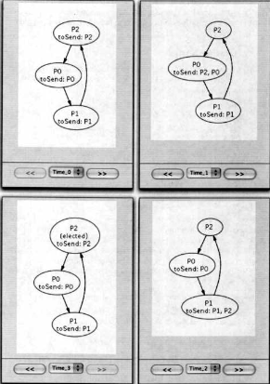
Simulation
Now we can get the Alloy Analyzer to do a simulation – create instances for multiple time steps, starting from T0.
pred show {
some elected
}
run show for 3 Process, 4 Time

Slide 88
Init: Each process has its own identifier in its pool.
Elected: none
Step 1: Process P2 selects an identifier – P2 – from its pool and adds it to P0’s pool.
Elected: none
Step 3: Process P1 selects an identifier – P2 – from its pool and adds it to P2’s pool.
Elected: P2.
Step 2: Process P0 selects an identifier – P2 – from its pool and adds it to P1’s pool.
Elected: none

Slide 89
Let’s check that one process is elected leader
When possible, it’s best to split a property into subproperties and check them individually. This makes it easier to diagnose what went wrong if a property doesn’t hold.
At most one process is elected leader
One process is elected leader
split
At least one process is elected leader

Slide 90
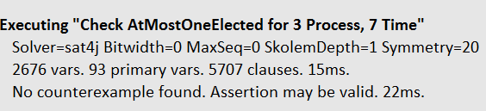
At most one process is elected
assert AtMostOneElected {
lone elected.Time
}
check AtMostOneElected for 3 Process, 7 Time
Over all Time, at most one process is elected

Slide 91
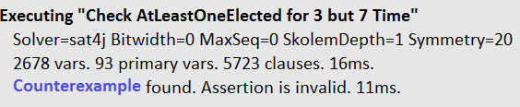
At least one process is elected
assert AtLeastOneElected {
some t: Time | some elected.t
}
check AtLeastOneElected for 3 but 7 Time
There is one or more Time, where at least one process is elected

Slide 92
Every process does a “Skip” at each time period.

Slide 93
Every process does a “Skip” at each time period.
So we need to force the processes to make progress.

Slide 94
Force processes to make progress
We can force progress by insisting that whenever some processes have a non-empty identifier pool, one or more of them must make a move.
pred progress {
all t: Time - last |
some Process.toSend.t =>
some p: Process | not skip [t, t.next, p]
}
At every time t at least one process (with identifiers in its pool) does not do a skip.

Slide 95
If one or more processes have an identifier in their pool then …
pred progress {
all t: Time - last |
some Process.toSend.t =>
some p: Process | not skip [t, t.next, p]
}

Slide 96
If one or more processes have an identifier in their pool then one or more processes does not do a skip.
pred progress {
all t: Time - last |
some Process.toSend.t =>
some p: Process | not skip [t, t.next, p]
}

Slide 97
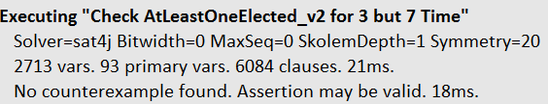

assert AtLeastOneElected_v2 {
progress => some elected.Time
}
check AtLeastOneElected_v2 for 3 but 7 Time

Slide 98
A few final comments

Slide 99
Idiom we used in the leader election model
Idiom: add a time atom in the last column of a relation to make it time-dependent. Order time atoms into traces.

Slide 100
Satisfy properties
Every protocol, every software program, every system must have states where one or more properties hold. For example, in these slides we saw:
  Properties that must be satisfied by a decentralized leader election: At most one leader gets elected. Some leader is eventually elected.
The purpose of a model is to represent the protocol, software, or system so that we can check that the properties hold.

Slide 101
How to configure the
Alloy display

Slide 102
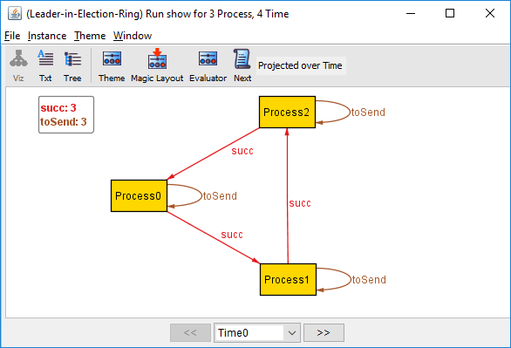
Default Alloy display
Here’s the visualization you get by default:
pred show {
some elected
}
run show for 3 Process, 4 Time

Slide 103
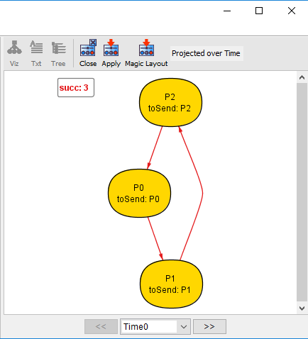
This is the display we want
pred show {
some elected
}
run show for 3 Process, 4 Time

Slide 104
Click on this

Slide 105
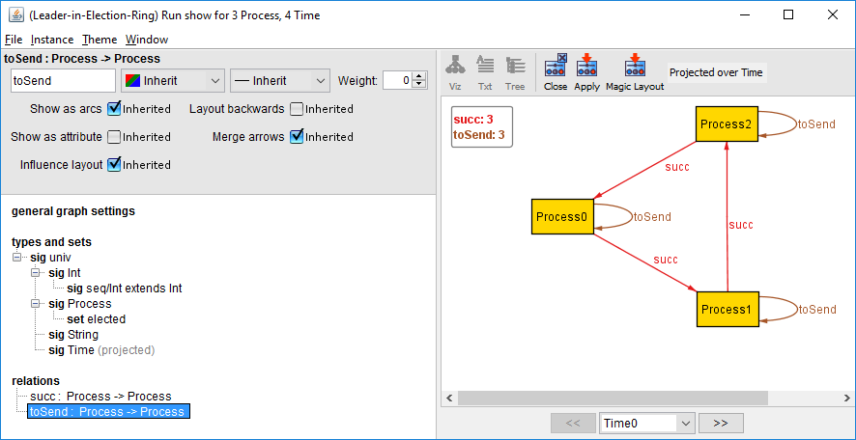
select this

Slide 106
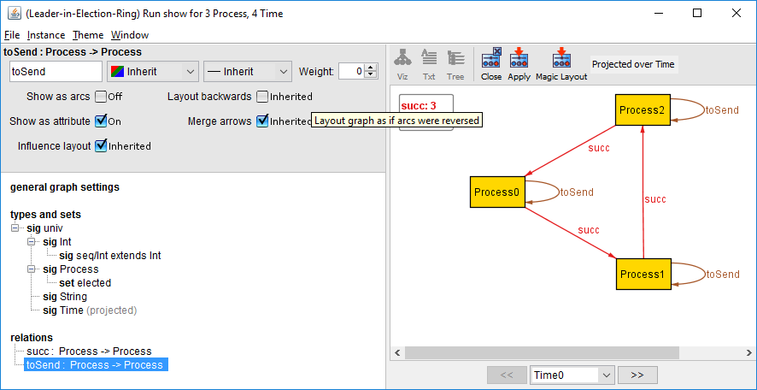
click this off
click this on

Slide 107
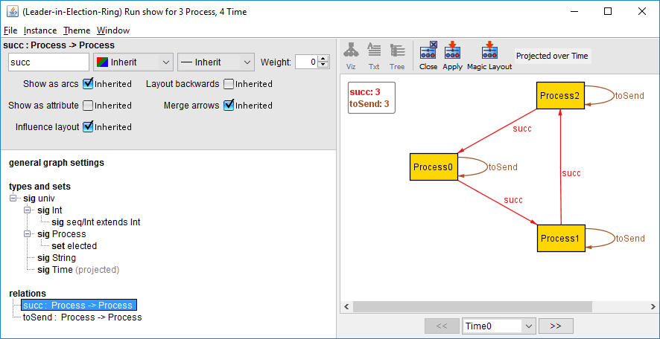
select this

Slide 108
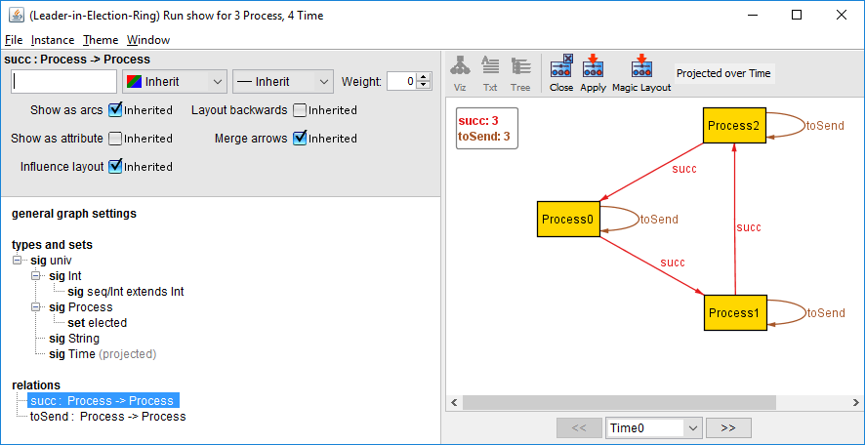
edit the label of succ to be the empty string

Slide 109
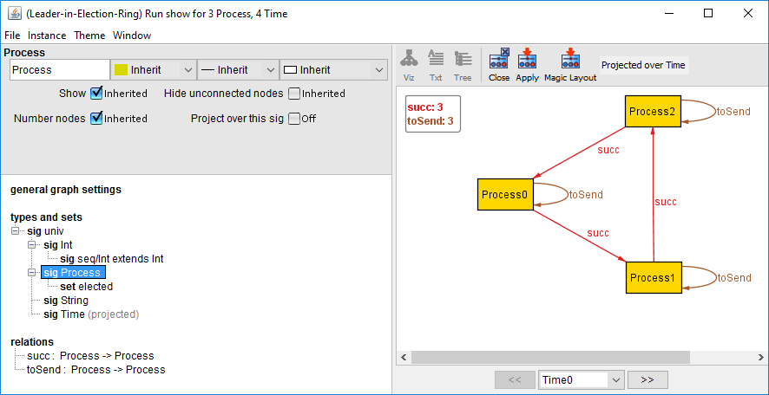
select this

Slide 110
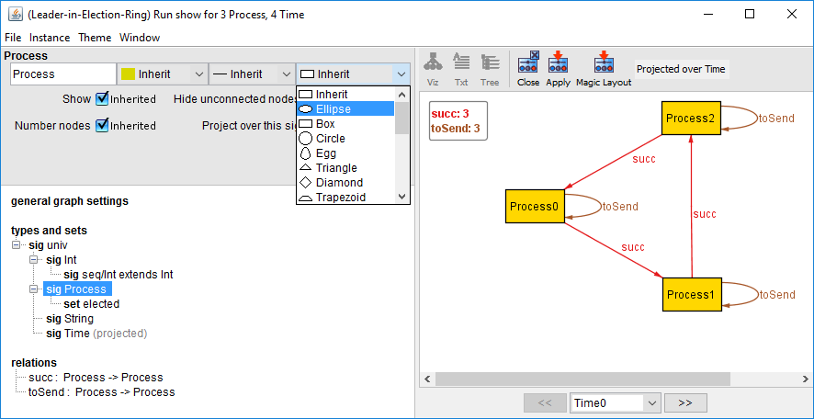
change the shape of Process nodes to ellipse

Slide 111

change the label prefix for Process to P

Slide 112

click on Apply
project over time

