Slide 1
A Gentle Introduction to Software Modeling & Analysis using Alloy
Roger L. Costello
Oct. 17, 2017

Slide 2

Table of Contents
Introduction to modeling, analysis, and Alloy
Learn a bit about the tool we will model/analyze – lots of screenshots
A model of the tool
Analysis of the model
The model, expressed in the Alloy modeling language
Analysis, expressed in the Alloy modeling language

Slide 3
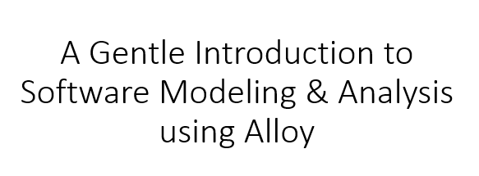
What is a model?

Slide 4
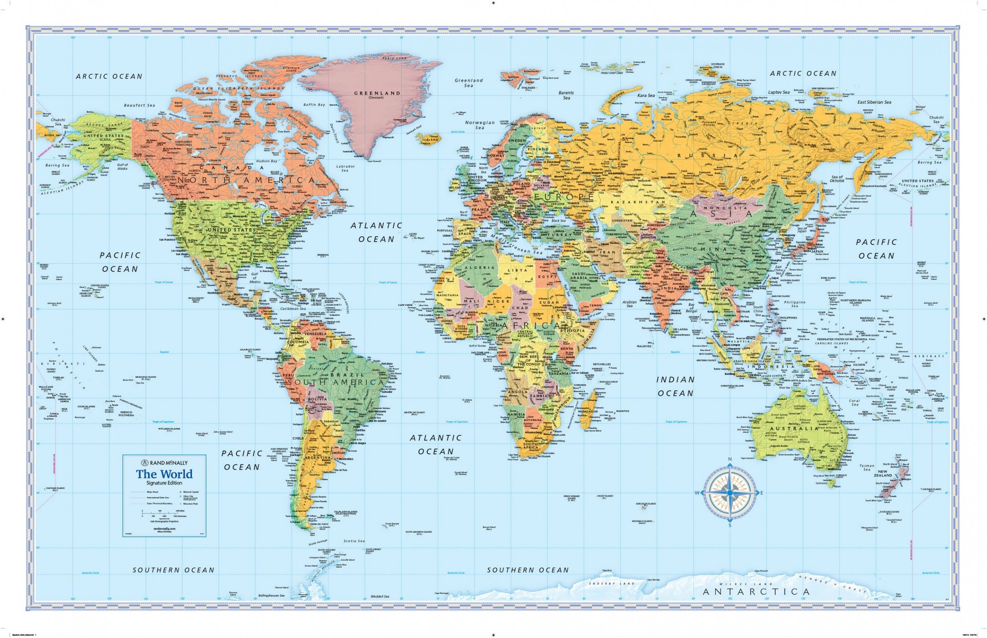
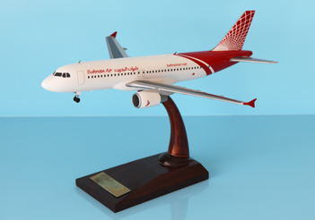
A map is a model of the physical world
This is a model of an actual airplane

Slide 5
A model is the essence of something, it is an abstraction of something

Slide 6
What is
analysis?

Slide 7
Aircraft companies create models before building an aircraft.
Why?

Slide 8
Answer: Because models are more convenient to analyze. An actual aircraft contains lots of details that are irrelevant for analysis.
Aircraft models can be analyzed: they can be put through wind tunnels to check for aerodynamic efficiency, computers can check flight behavior, and so forth.

Slide 9
Why do people create software models?
model of the software
software
(application)

Slide 10
Answer: Because models are more convenient to analyze. The actual software contains lots of details that are irrelevant for analysis.
Software models can be analyzed: they can be checked for security vulnerabilities, checked for the presence (or absence) of required properties, and so forth.
model of the software
software
(application)
key
point
key
point

Slide 11
What is
Alloy?

Slide 12
Alloy = language + tool
Alloy is a language for creating software models
The Alloy Analyzer is a tool that evaluates your models
Find vulnerabilities in the model
Generate instances that satisfy the model

Slide 13

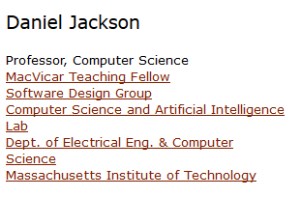
Alloy was created at MIT by Daniel Jackson
http://alloy.mit.edu/alloy/

Slide 14
Table of Contents
Introduction to modeling, analysis, and Alloy
Learn a bit about the tool we will model/analyze – lots of screenshots
A model of the tool
Analysis of the model
The model, expressed in the Alloy modeling language
Analysis, expressed in the Alloy modeling language

Slide 15
We will model a tool that manages photos
The tool is called Phase One (www.phaseone.com)
We will model a few of its essential commands

Slide 16
We will model a tool that manages photos
The tool is called Phase One (www.phaseone.com)
We will model a few of its essential commands
a.k.a., the “application” (I will use the terms “tool” and “application” interchangeably)

Slide 17
Benefit of modeling an existing tool
Ideally, models are created first and then the tool (software) is built.
Analogously, aircraft models are created first, before building the actual aircraft.
Nonetheless, it is useful to model an existing tool:
Get deep insight into the tool's commands.
At first glance a tool's commands may seem obvious, but are subtler when examined carefully.
A model can expose errors and confusions in the tool.
If there are plans to extend the tool, a model can identify if the new functionality will compromise the clarity of existing key abstractions.

Slide 18
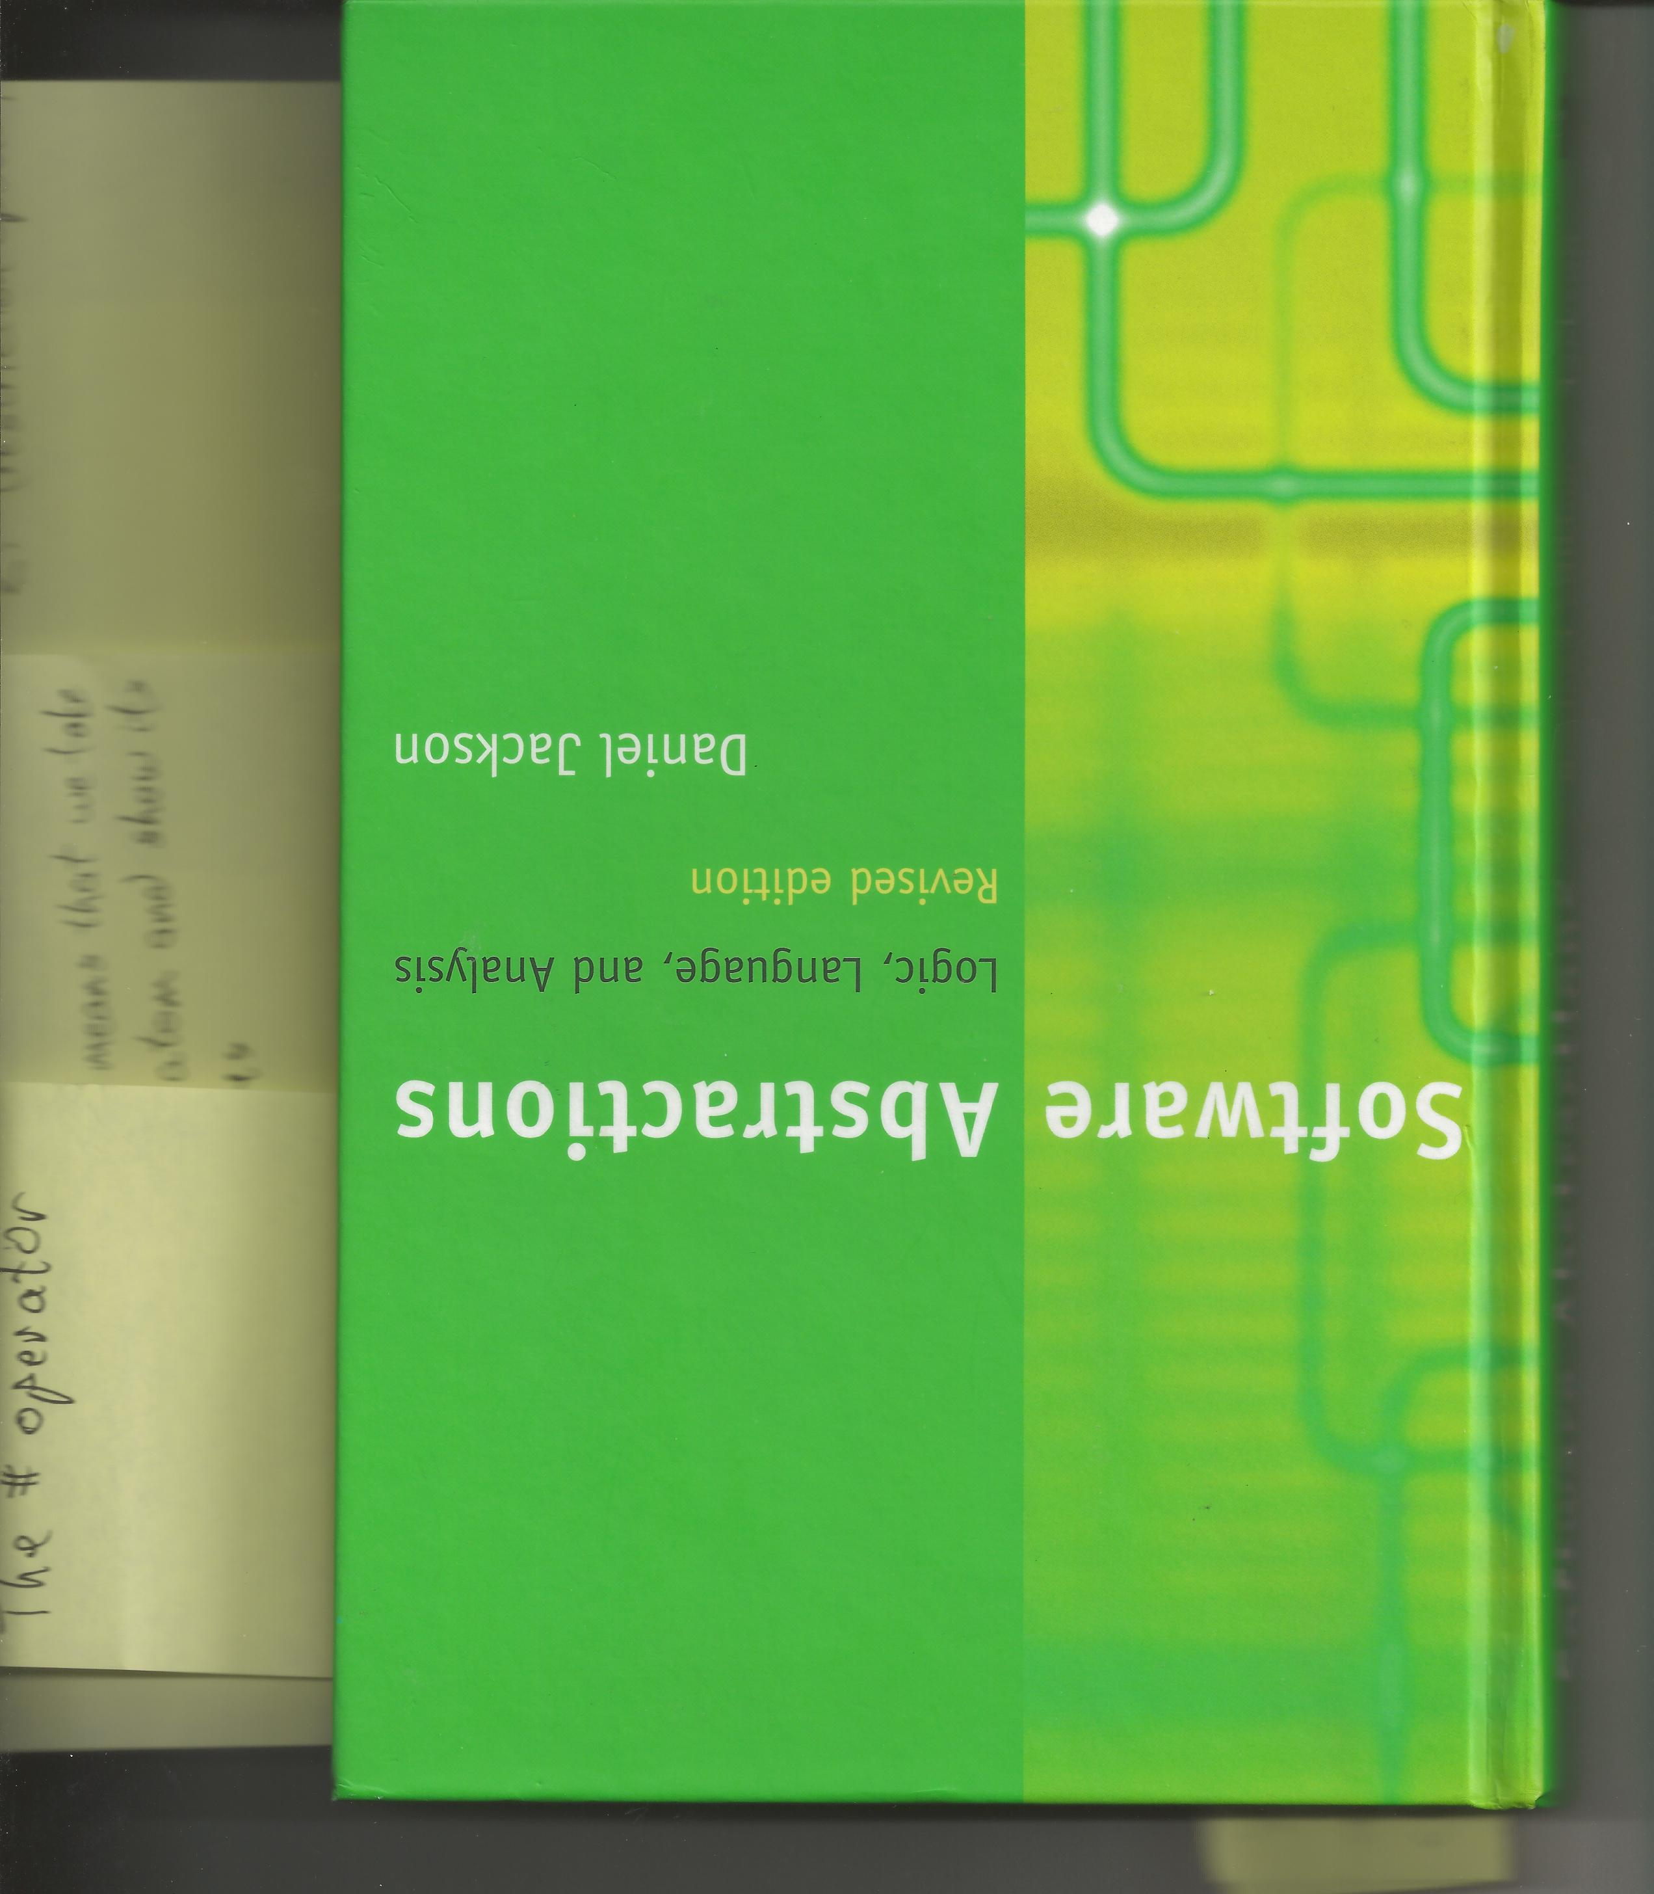
Acknowledgement
The model shown in these slides comes from this fantastic book, pages 205-219.

Slide 19
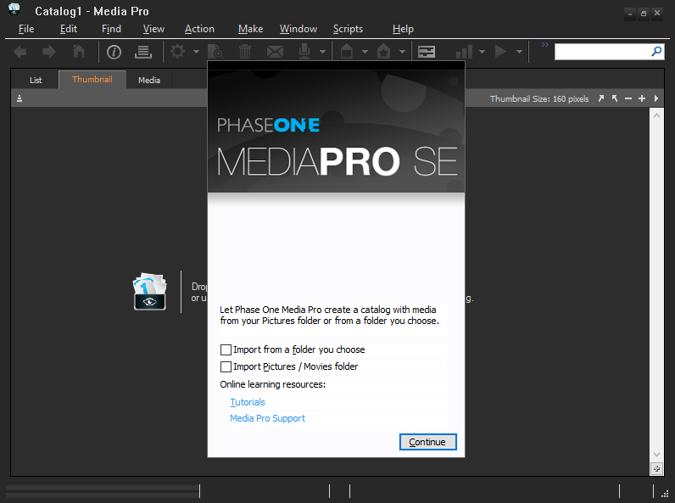
This is the first screen you see when you open the application

Slide 20

Import your photos into the tool

Slide 21
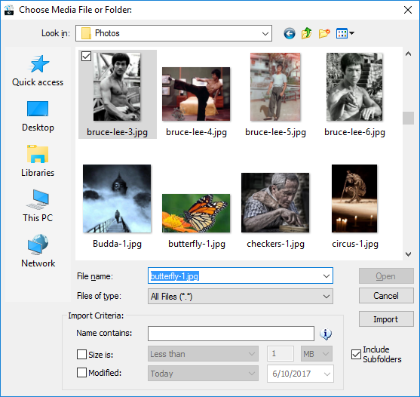
Open a folder and select a photo

Slide 22
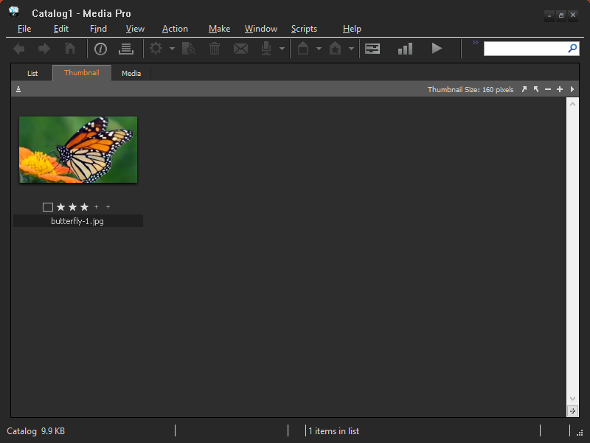
The tool organizes photos into “catalogs”

Slide 23
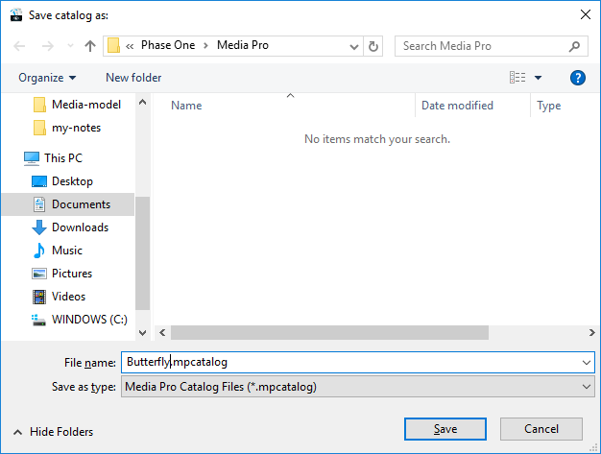
Give the catalog a name

Slide 24

Butterfly catalog

Slide 25
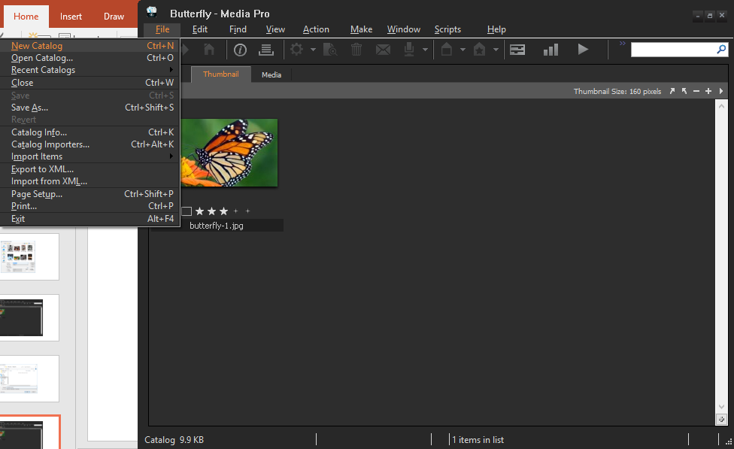
Create a second catalog

Slide 26
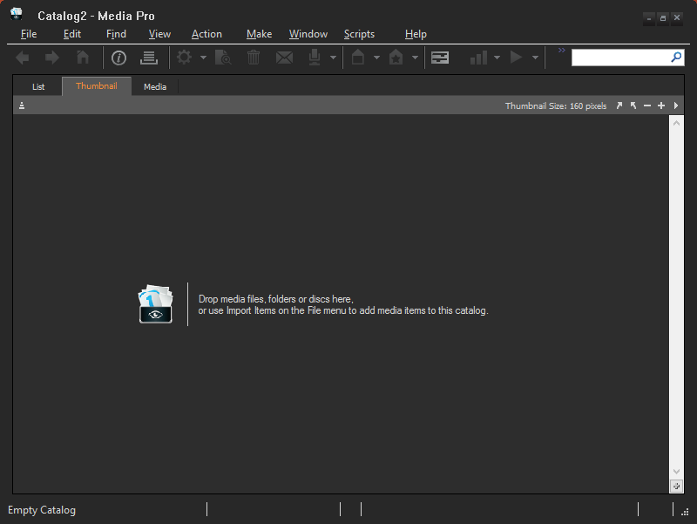
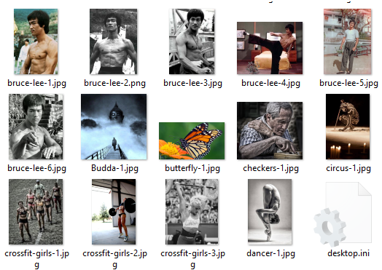
Drag and drop Bruce Lee photos in here

Slide 27
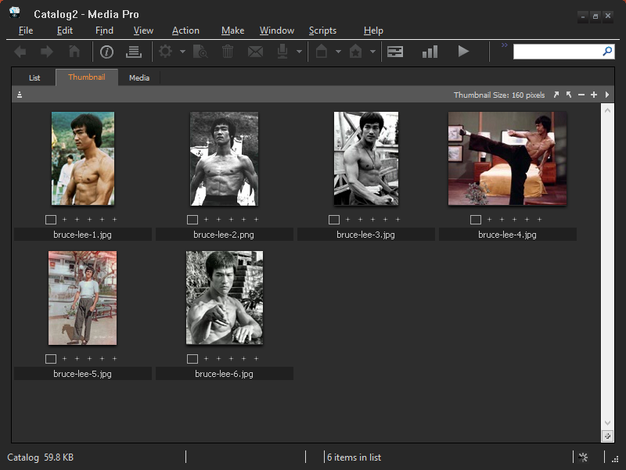
A bunch of photos placed into this catalog

Slide 28
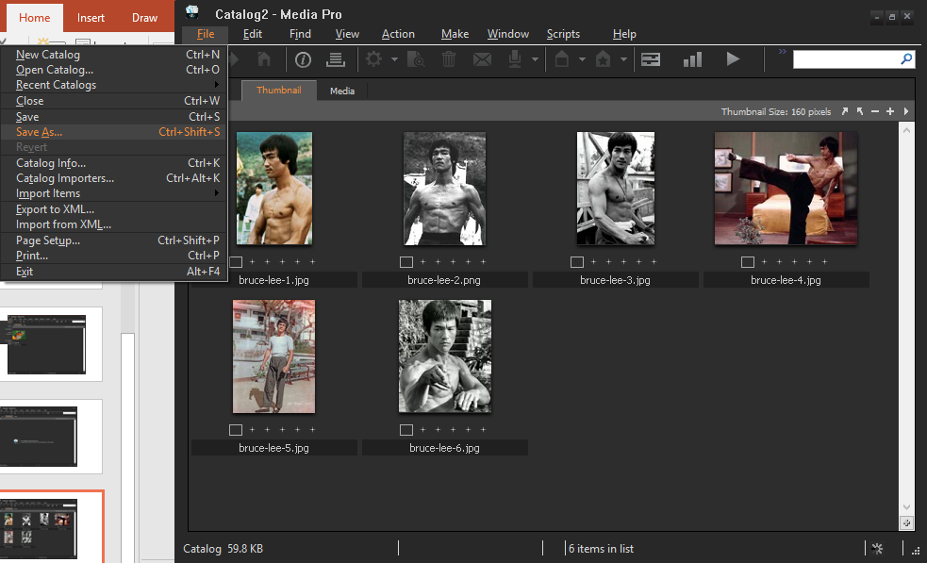
Save the catalog under a name

Slide 29
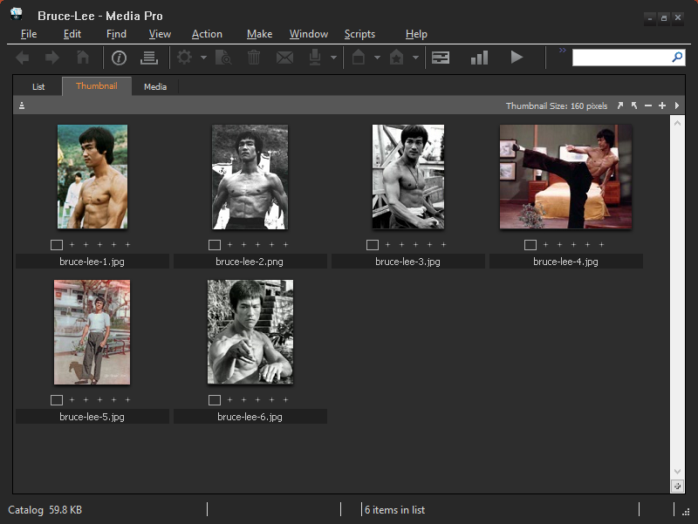
Bruce Lee catalog

Slide 30
Create more catalogs …

Slide 31
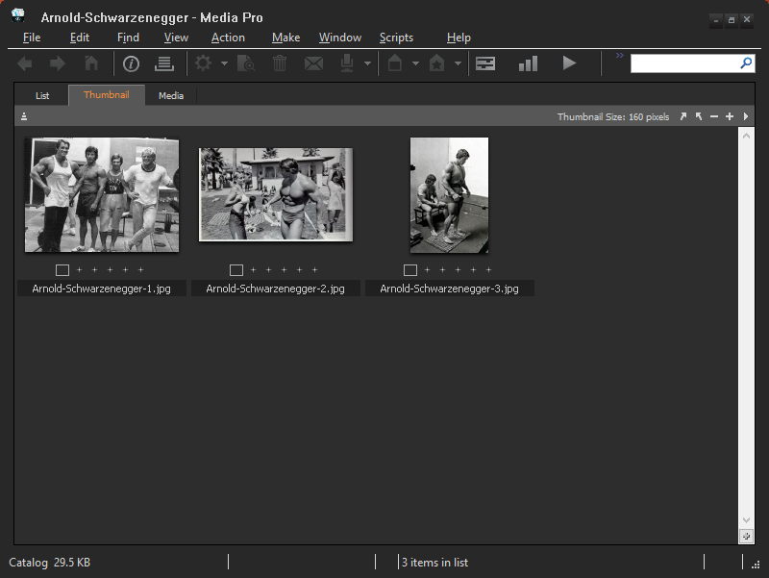
Arnold Schwarzenneger catalog

Slide 32
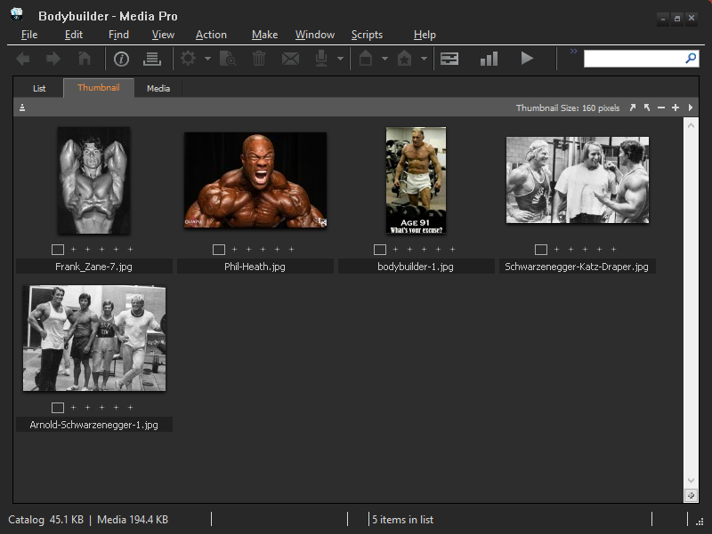
Bodybuilder catalog

Slide 33
Summary
The tool (application) contains catalogs
Each catalog contains photos (assets)

Slide 34
Summary
The tool (application) contains catalogs
Each catalog contains photos (assets)
I will often use the general term “assets” because the tool can manage more than just photos. It can also manage movies and soundtracks.

Slide 35
“select” photos

Slide 36
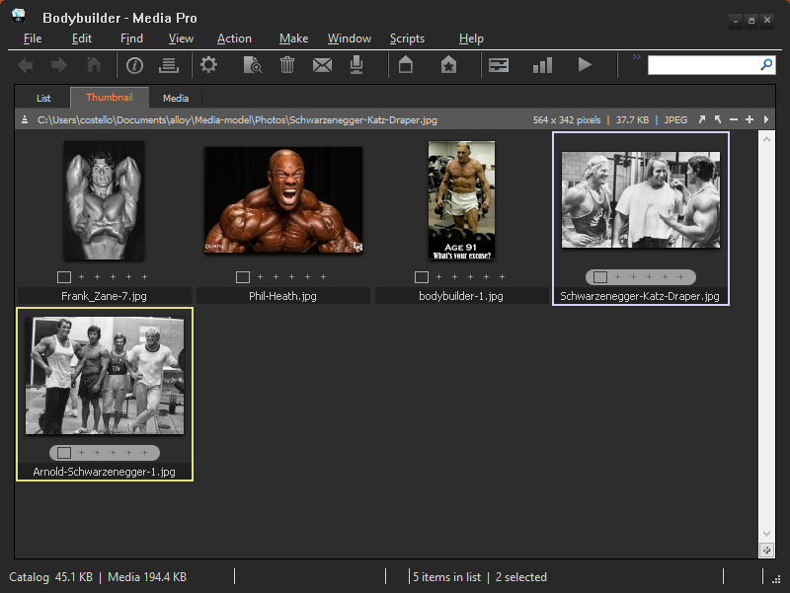
Two photos were “selected” by clicking on them

Slide 37
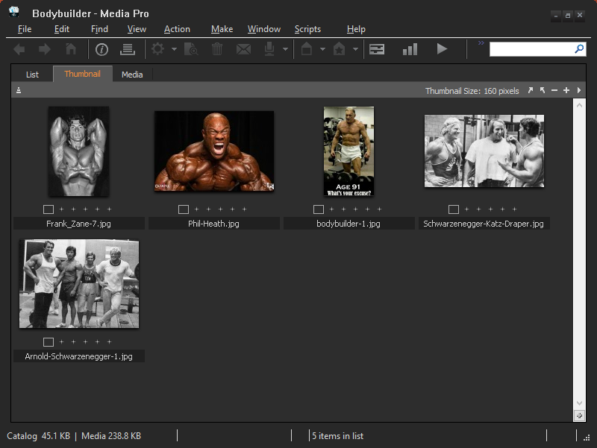
No photos selected
i.e., selection = empty (Undefined)

Slide 38
Five photos “showing”
Two photos “selected”

Slide 39
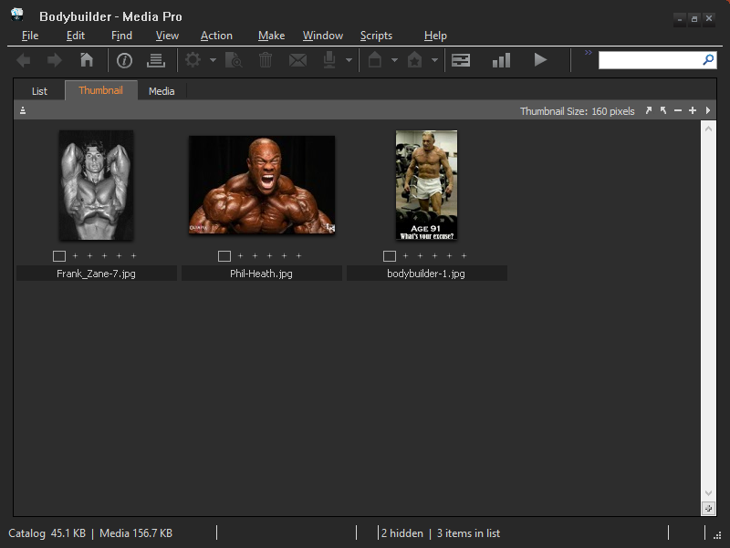
2 “hidden” photos

Slide 40
Can only select photos that are showing (i.e., cannot select hidden photos)

Slide 41
“selection” is either Undefined (empty) or a subset of “showing”

Slide 42
“selection” is either Undefined (empty) or a subset of “showing”
This is true for every catalog, i.e., it's an invariant.

Slide 43
Let's cut two photos from the Bodybuilder catalog and paste them to the Arnold Schwarzenegger catalog

Slide 44
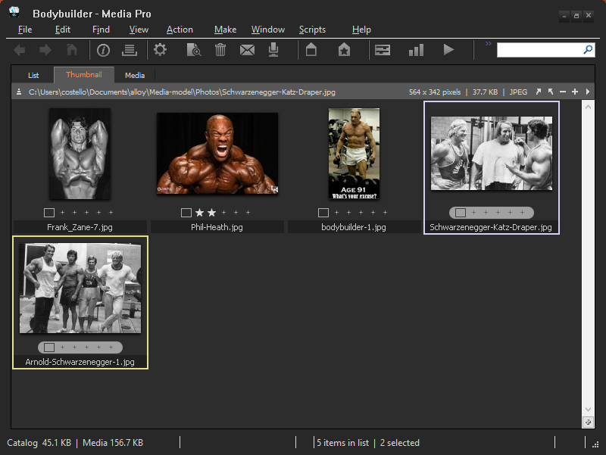

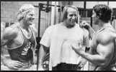
Bodybuilder catalog
Clipboard
Arnold Schwarzenegger catalog
cut
paste

Slide 45
Select the photos to be cut

Slide 46
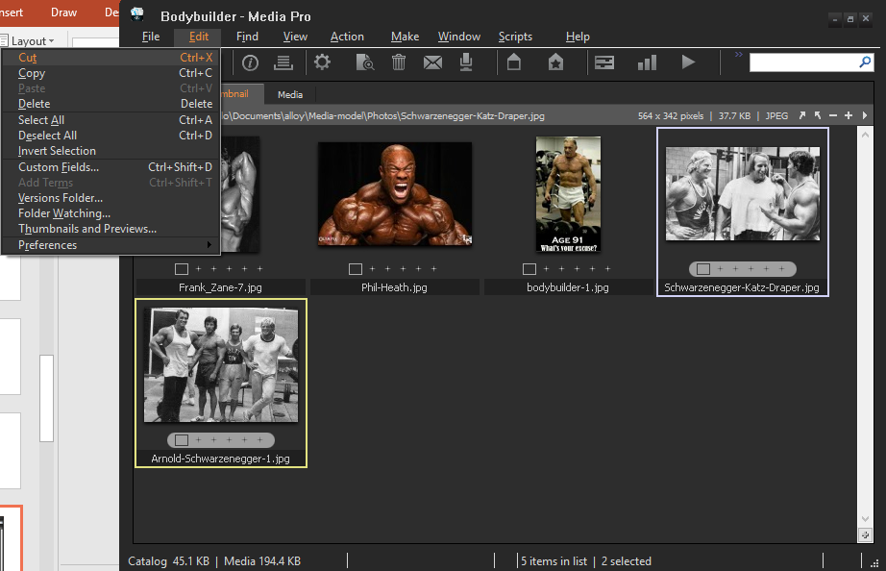
“Cut” the selected photos

Slide 47
Clipboard
The cut photos are stored in the application's clipboard

Slide 48
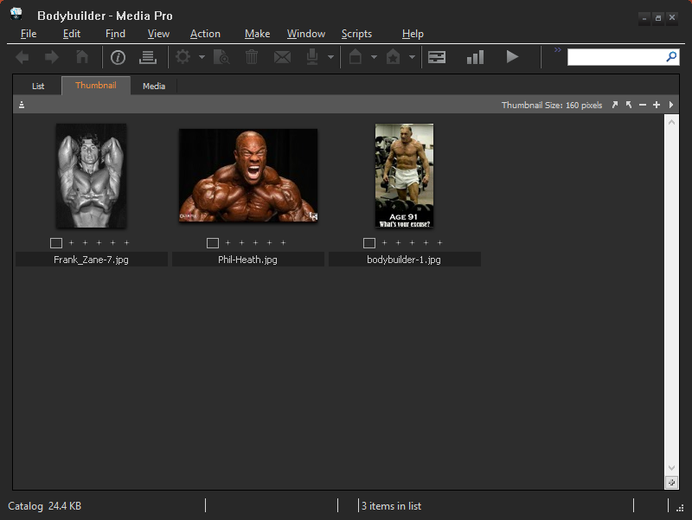
The catalog after executing the cut command

Slide 49
Can we execute a “cut” command if nothing is selected?

Slide 50
No photos are selected

Slide 51
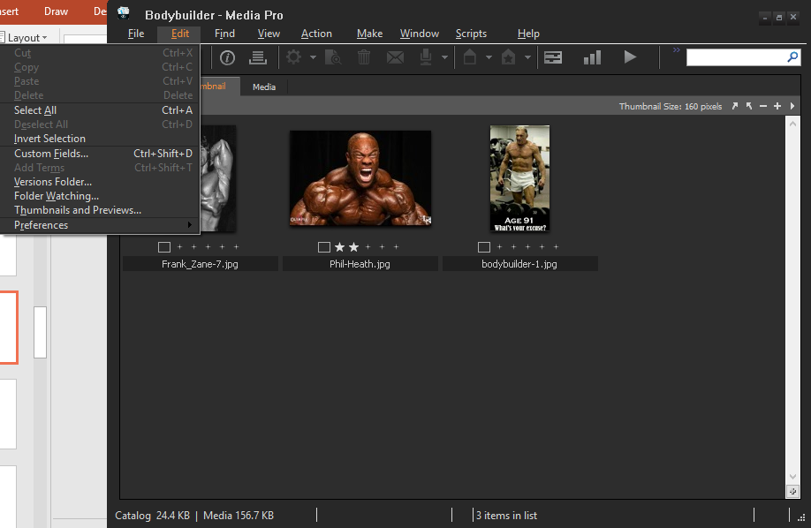
“Cut” is grayed out

Slide 52
The cut command can only be executed when one or more photos are selected

Slide 53
Now let's paste the photos in the clipboard to the Arnold Schwarzenegger catalog

Slide 54

Clipboard
paste

Slide 55
Clipboard
This photo already exists in the catalog

Slide 56
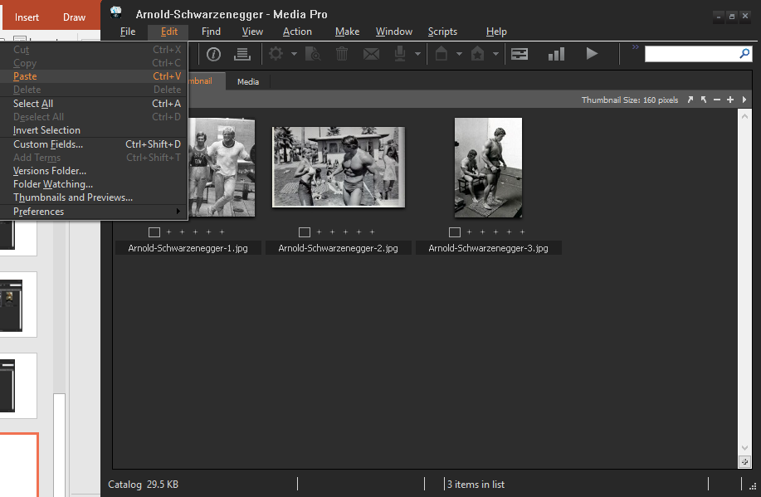
“Paste” the photos in the clipboard into this catalog

Slide 57
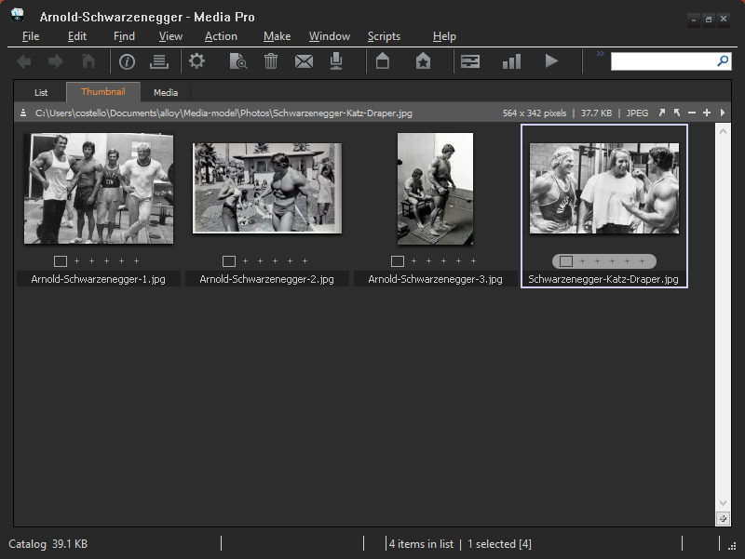
Catalog after executing the paste command

Slide 58
Notice that the pasted photo is “selected” and the other photo is not pasted since it already existed in the catalog

Slide 59
Now let's see how to hide assets

Slide 60
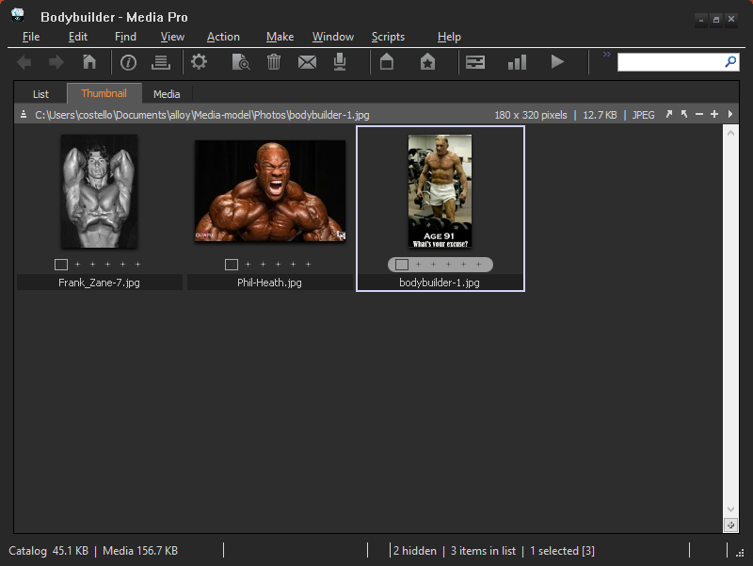
Select a photo.

Slide 61
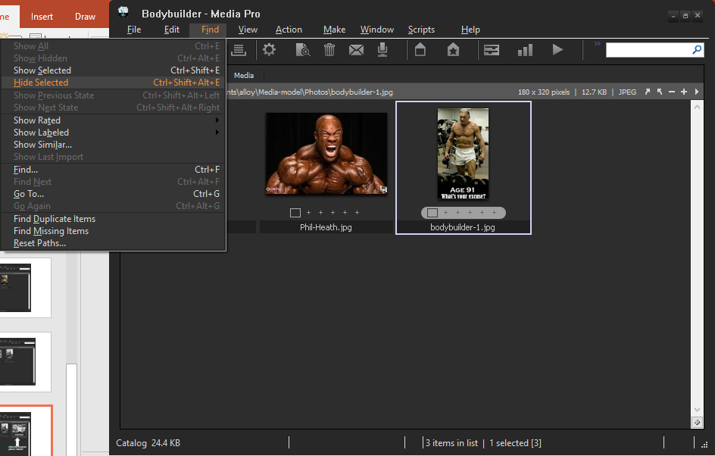
Select the
“Hide Selected” command

Slide 62
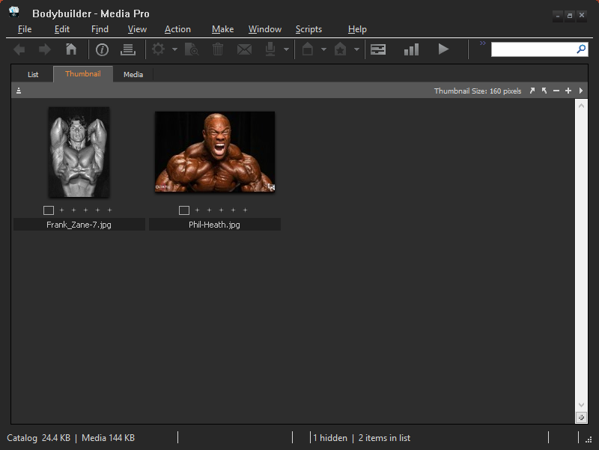
1 hidden photo

Slide 63
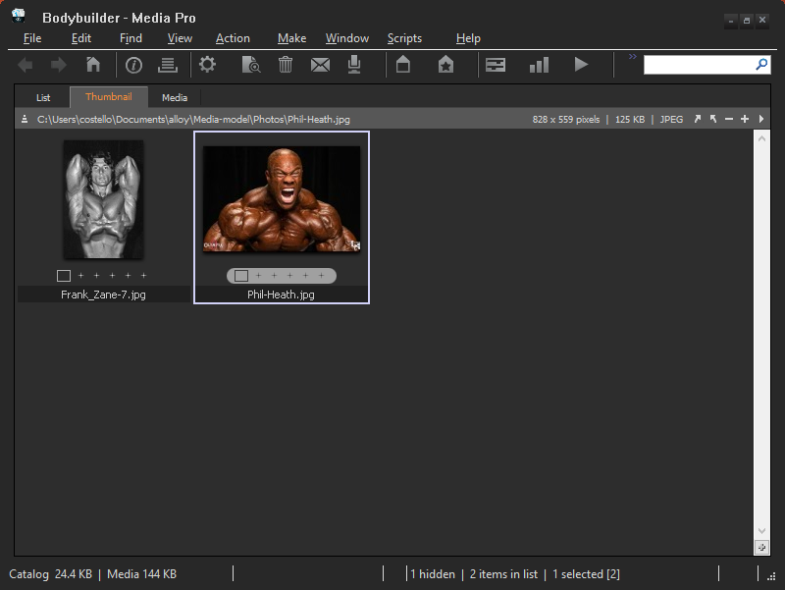
Hide this photo as well

Slide 64
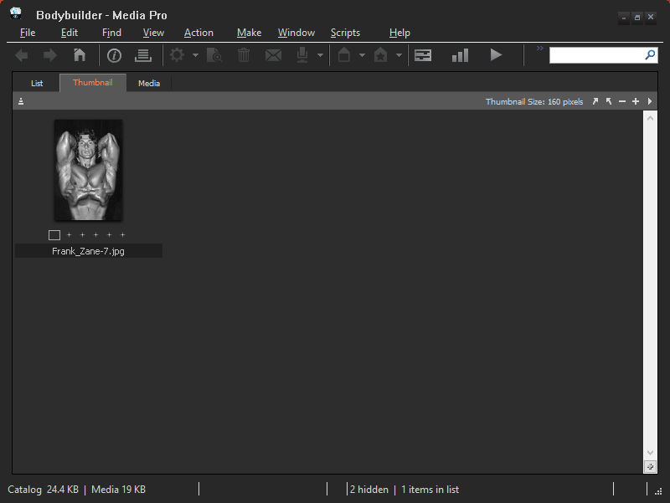
2 hidden photos

Slide 65
Can we execute a hide command if no photos are selected?

Slide 66
No photos selected

Slide 67
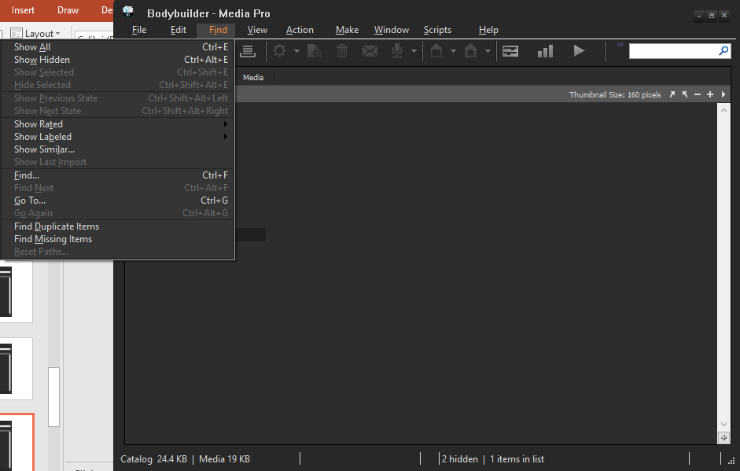
“Hide Selected” is grayed out

Slide 68
The hide selected command can only be executed when one or more photos are selected

Slide 69
After executing a hide selected command, are the hidden photos still selected?

Slide 70
After executing a hide selected command, are the hidden photos still selected?
How can we tell? After all, we can't see the hidden photos.

Slide 71
See if the “cut” command is grayed out – recall that it is available only if assets are selected

Slide 72
I just finished the “Hide Selected” command. Are any of the hidden photos selected?

Slide 73
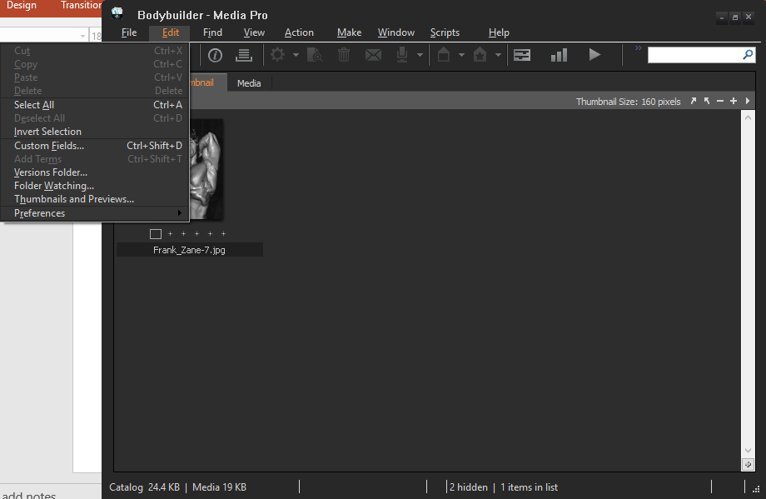
“Cut” is grayed out

Slide 74
There are no selected photos after executing the “Hide Selected” command, either in the visible section or in the hidden section

Slide 75
What's the relationship between hidden photos and showing photos?

Slide 76
1 photo showing
2 hidden photos

Slide 77
hidden + showing = assets

Slide 78
What happens if we paste a photo that is already present in the hidden area? Will the hidden photo move to showing?

Slide 79
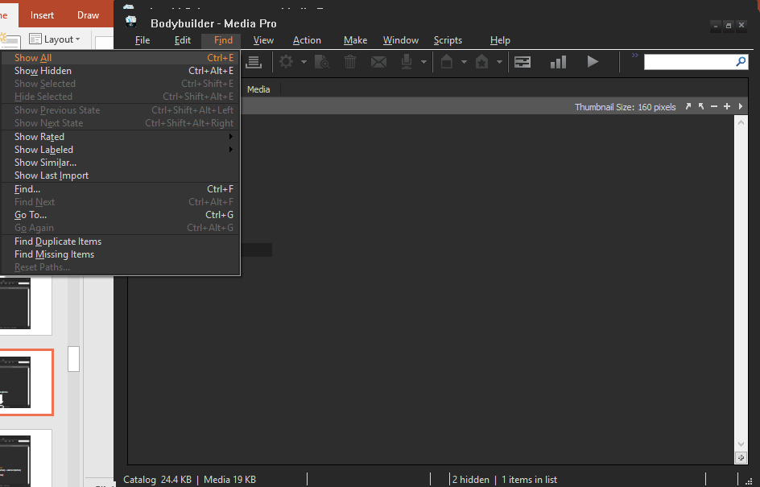
Show All

Slide 80

All the photos in this catalog are showing (no hidden photos)

Slide 81
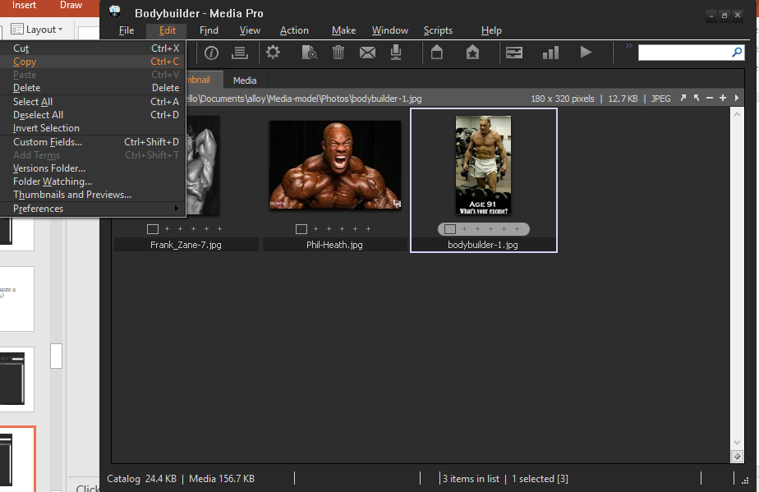
Copy the selected photo

Slide 82
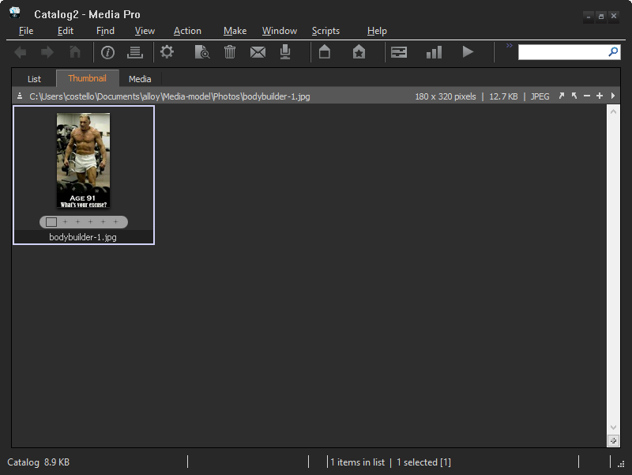
Create a new catalog and paste the photo into it. Here's the result.

Slide 83
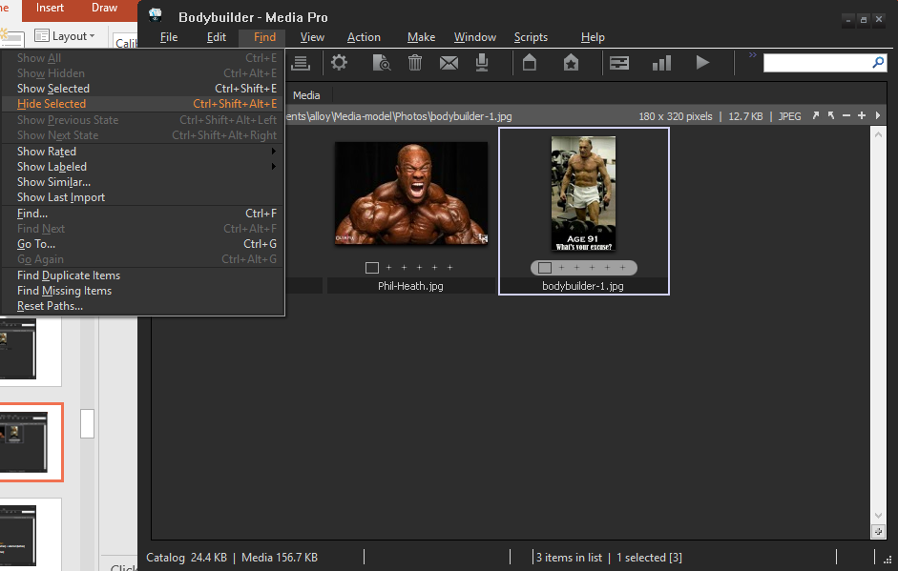
Back to the other catalog. Hide the photo.

Slide 84

1 hidden photo

Slide 85
The photo is in two catalogs

Slide 86
Cut the photo from here and paste it into this catalog

Slide 87

Here's the result. The photo remains hidden
1 hidden photo

Slide 88
Pasting does not cause a photo to go from hidden to showing

Slide 89
Let's see how to show only the photos that are selected

Slide 90
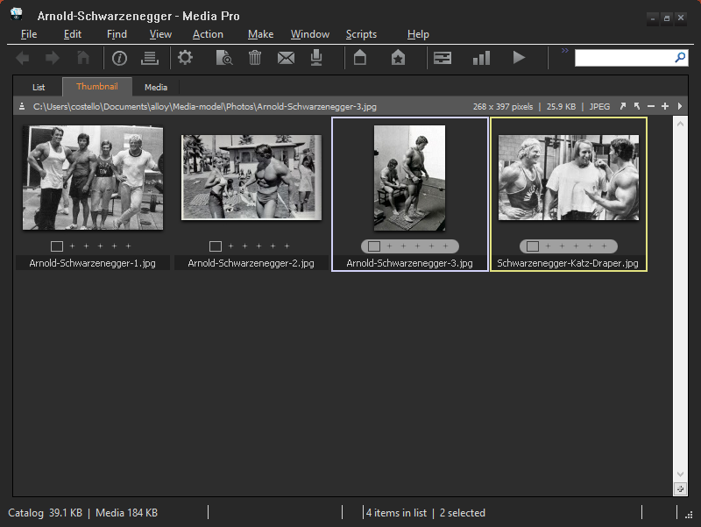
Select some photos

Slide 91
We want to show only the selected photos

Slide 92
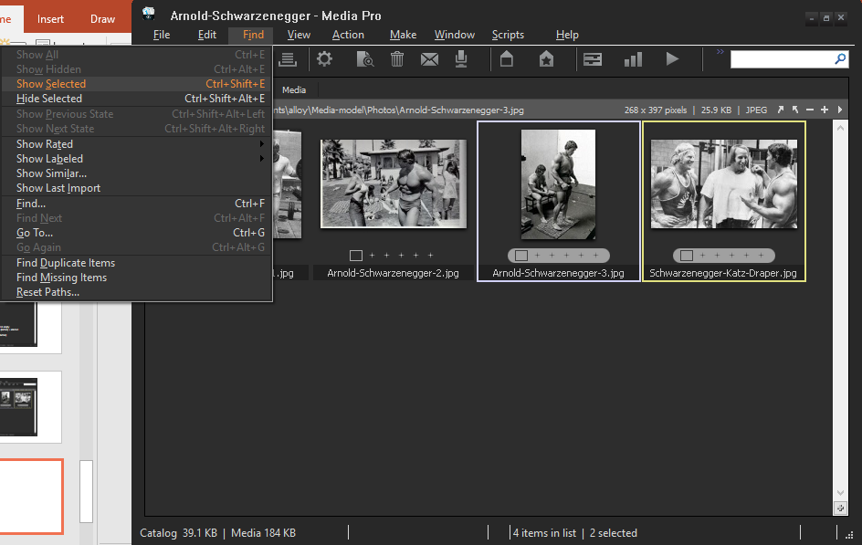
“Show Selected” command

Slide 93
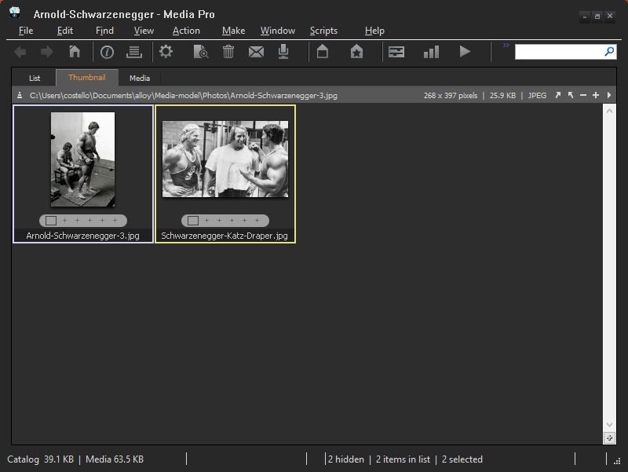
Catalog after executing the “Show Selected” command

Slide 94
2 hidden photos

Slide 95
Notice that the selected assets remain selected

Slide 96
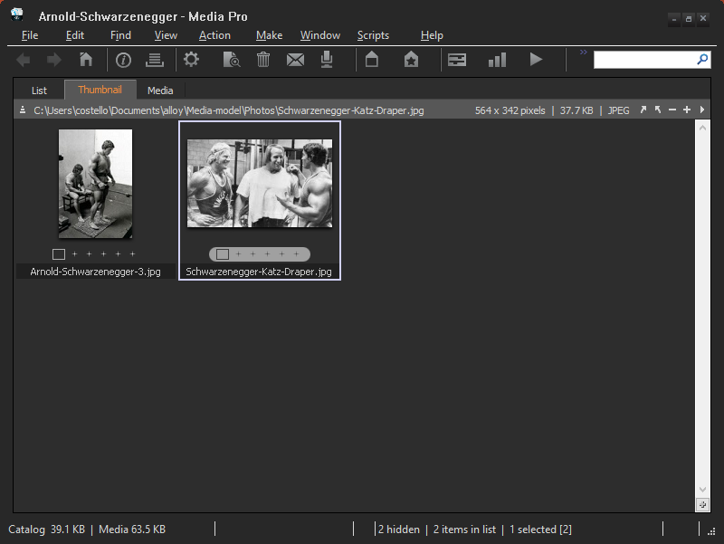
Now let's show just one photo, so select it

Slide 97
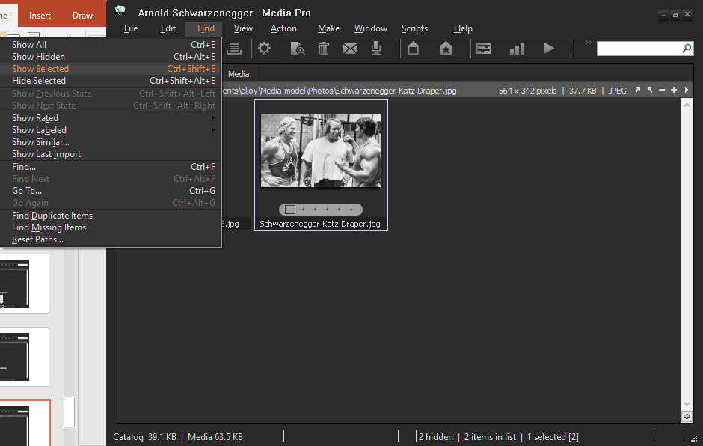
“Show Selected” command

Slide 98
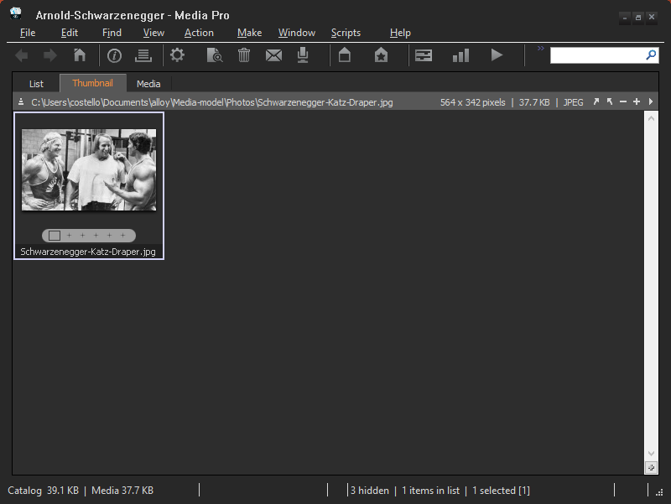
Catalog after executing the “Show Selected” command

Slide 99
3 hidden photos

Slide 100
What will happen if we execute “Show Selected” when no photos are selected?

Slide 101
No photos selected

Slide 102
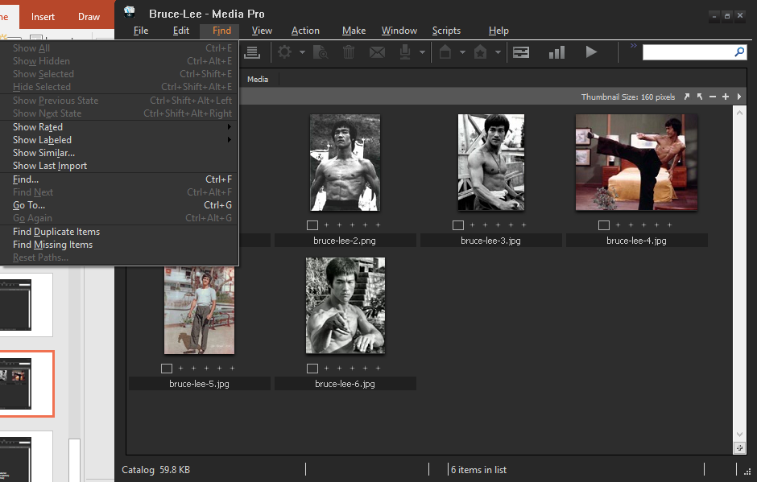
“Show Selected” is grayed out

Slide 103
The “Show Selected” command can be executed only when one or more photos are selected

Slide 104
Both “Hide Selected” and “Show Selected” hide assets
After the “Hide Selected” command
After the “Show Selected” command
hidden photos
hidden photos

Slide 105
Difference between “Hide Selected” and “Show Selected”
After the “Hide Selected” command
After the “Show Selected” command
selection (after) = empty
selection (after) = selection (before)

Slide 106
Phew! Time for a breather
We've seen a few of the tool's commands.
Even with these few commands, the details are getting a bit complex – after executing this command the remaining assets are not selected, after executing that command the remaining assets are selected.
A model would be very helpful. It would enable us to capture these details, without getting mired in irrelevant details.
So, let's start modeling!
key
point

Slide 107
Table of Contents
Introduction to modeling, analysis, and Alloy
Learn a bit about the tool we will model/analyze – lots of screenshots
A model of the tool
Analysis of the model
The model, expressed in the Alloy modeling language
Analysis, expressed in the Alloy modeling language

Slide 108
3 parts to modeling
Structure: Identify the things that are relevant, such as catalogs, assets, hidden assets, showing assets, etc.
Behavior: Describe the effect of commands on the things. For example, the “Hide Selected” command augments the hidden assets and subtracts from the showing assets.
Analysis: Create instances that conform to the model. Analyze the model for errors and vulnerabilities. Check the model for presence (or absence) of desired properties. For example, if we execute a cut followed by a paste is the application the same after as before?

Slide 109
(1) Structure: Identify relevant things

Slide 110
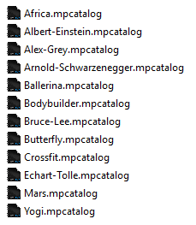
Catalogs

Slide 111
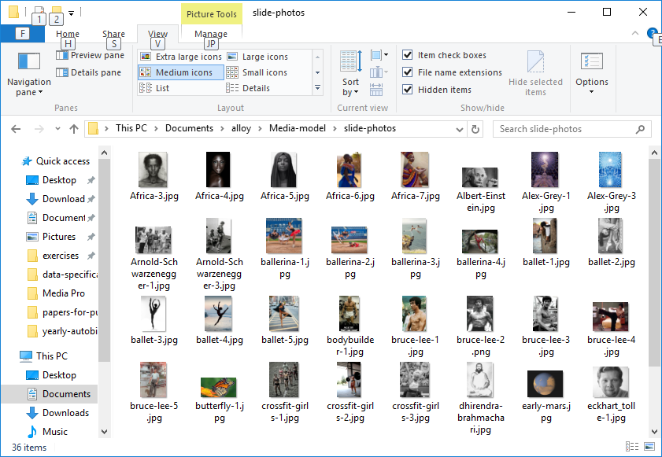
Assets

Slide 112
Selection
Two photos “selected”

Slide 113
Hidden
2 “hidden” photos

Slide 114
Showing
Five photos “showing”

Slide 115
Clipboard
Bodybuilder catalog
Clipboard
Arnold Schwarzenegger catalog
cut
paste

Slide 116
Summary of relevant things
- catalogs
- assets
- selection (set of selected assets)
- hidden (set of hidden assets)
- showing (set of assets that are showing)
- clipboard

Slide 117
Summary of relevant things
- catalogs
- assets
- selection (set of selected assets)
- hidden (set of hidden assets)
- showing (set of assets that are showing)
- clipboard
key
point
If we were to look inside the tool would we see these things? Is this all we would see? No. This is our “abstraction” of the tool. It is the collection of things that represent our understanding of the tool. It is part of our model of the tool.

Slide 118
Next, identify things that describe the state of the application

Slide 119
Open catalogs
Open catalogs

Slide 120
For each open catalog, the catalog's state
state of this catalog
state of this catalog
state of this catalog
state of this catalog

Slide 121
The “current” catalog
The catalog that I am working on at this moment

Slide 122
Assets on the clipboard

Slide 123
Summary of things that describe the state of the application
- the set of open catalogs
- for each open catalog, its state
- the “current” catalog
- assets on the clipboard

Slide 124
Next, identify things that describe the state of a catalog

Slide 125
Catalog's assets
The photos (assets) that are in the Bruce Lee catalog

Slide 126
Catalog's assets that are showing, that are hidden
showing
hidden

Slide 127
Catalog's assets that are selected
selected

Slide 128
Summary of the things that describe the state of a catalog
- the catalog's assets
- the catalog's assets that are showing
- the catalog's assets that are hidden
- the catalog's assets that are selected (or none selected)

Slide 129
(2) Behavior: Describe the effects of each command on the things in the previous slides

Slide 130
First, some notation
Let:
xs denote the application’s state before executing the command
xs' denote the application’s state after executing the command
cs denote the state of the current catalog before executing the command
cs' denote the state of the current catalog after executing the command
buffer denote the application’s clipboard
Undefined denote no selection (selection is empty)

Slide 131
Describe the effects of the “cut” command

Slide 132

Precondition to using the cut command: photos must be selected
No photos selected

Slide 133
Precondition to using the cut command: photos must be selected
cs.selection != Undefined

Slide 134


An effect of the cut command is to replace the content of the clipboard with the selection

Slide 135
An effect of the cut command is to replace the content of the clipboard with the selection
xs'.buffer = cs.selection

Slide 136
Contrast with the behavior of the emacs editor
cut
The stuff in the clipboard is not overwritten. It is pushed onto a stack.
stack

Slide 137
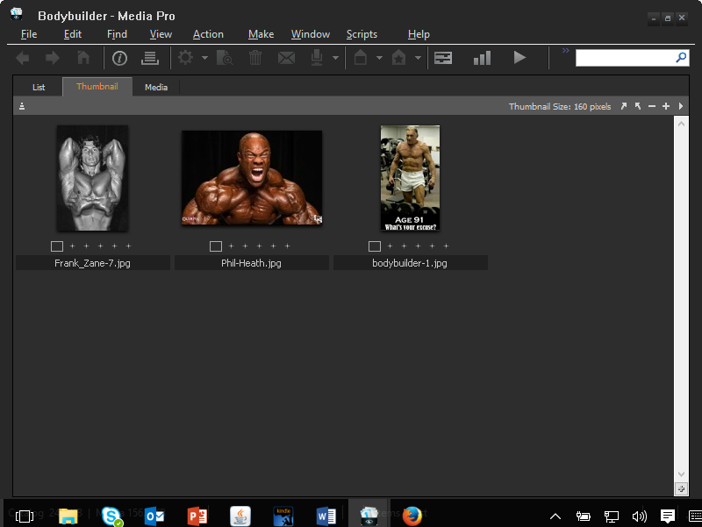
An effect of the cut command is to remove the selected assets from the catalog
cut

Slide 138
An effect of the cut command is to remove the selected assets from the catalog
cut
cs'.assets = cs.assets - cs.selection

Slide 139
An effect of the cut command is to remove the selected assets from the set of showing assets
cut

Slide 140
An effect of the cut command is to remove the selected assets from the set of showing assets
cut
cs'.showing = cs.showing - cs.selection

Slide 141
An effect of the cut command is to clear selection
cut

Slide 142
An effect of the cut command is to clear selection
cut
cs'.selection = Undefined

Slide 143
With the cut command, only the current catalog changes

Slide 144
With the cut command, only the current catalog changes
xs'.catalogState = xs.catalogState ++ xs.currentCatalog -> cs'
Update the application's record of catalog states to reflect the modified catalog

Slide 145
With the cut command, no change to the set of open catalogs

Slide 146
With the cut command, no change to the set of open catalogs
xs'.catalogs = xs.catalogs

Slide 147
With the cut command, no change to which catalog is the “current” catalog

Slide 148
With the cut command, no change to which catalog is the “current” catalog
xs'.currentCatalog = xs.currentCatalog

Slide 149
Summary of the effects of the “cut” command
Precondition: cs.selection != Undefined
xs'.buffer = cs.selection
cs'.assets = cs.assets - cs.selection
cs'.showing = cs.showing - cs.selection
cs'.selection = Undefined
xs'.catalogState = xs.catalogState ++ xs.currentCatalog -> cs'
xs'.catalogs = xs.catalogs
xs'.currentCatalog = xs.currentCatalog

Slide 150
Describe the effects of the “paste” command

Slide 151
Notation
Let:
new denote the photos to be pasted into the catalog which are not already present in the catalog

Slide 152
An effect of the paste command is to add the new assets in the clipboard to the current catalog
paste

Slide 153
An effect of the paste command is to add the new assets in the clipboard to the current catalog
paste
cs'.assets = cs.assets + new

Slide 154
An effect of the paste command is to augment the set of showing assets with the new assets
paste

Slide 155
An effect of the paste command is to augment the set of showing assets with the new assets
paste
cs'.showing = cs.showing + new

Slide 156
An effect of the paste command is for selection to become the newly added assets (if there are some new assets, else Undefined)
paste

Slide 157
An effect of the paste command is for selection to become the newly added assets (if there are some new assets, else Undefined)
paste
cs'.selection = (some new => new else Undefined)

Slide 158
With the paste command, only the current catalog changes

Slide 159
With the paste command, only the current catalog changes
xs'.catalogState = xs.catalogState ++ xs.currentCatalog -> cs'
Update the application's record of catalog states to reflect the modified catalog

Slide 160
With the paste command, no change to the set of open catalogs

Slide 161
With the paste command, no change to the set of open catalogs
xs'.catalogs = xs.catalogs

Slide 162
With the paste command, no change to which catalog is the “current” catalog

Slide 163
With the paste command, no change to which catalog is the “current” catalog
xs'.currentCatalog = xs.currentCatalog

Slide 164
Summary of the effects of the “paste” command
xs'.buffer = xs.buffer
cs'.assets = cs.assets + new
cs'.showing = cs.showing + new
cs'.selection = (some new => new else Undefined)
xs'.catalogState = xs.catalogState ++ xs.currentCatalog -> cs'
xs'.catalogs = xs.catalogs
xs'.currentCatalog = xs.currentCatalog

Slide 165
Describe the effects of the “hide selected” command

Slide 166
Precondition to executing the hide selected command: photos must be selected
No photos selected

Slide 167
Precondition to executing the hide selected command: photos must be selected
cs.selection != Undefined

Slide 168
An effect of the hide selected command is to augment the set of hidden assets
hide
selected
1 hidden photo

Slide 169
An effect of the hide selected command is to augment the set of hidden assets
hide
selected
cs'.hidden = cs.hidden + cs.selection

Slide 170
An effect of the hide selected command is to clear the selection
hide
selected
1 hidden photo

Slide 171
An effect of the hide selected command is to clear the selection
hide
selected
cs'.selection = Undefined

Slide 172
No change to the set of assets in the catalog
1 hidden photo

Slide 173
No change to the set of assets in the catalog
cs'.assets = cs.assets

Slide 174
Summary of the effects of the “hide selected” command
Precondition: cs.selection != Undefined
cs'.hidden = cs.hidden + cs.selection
cs'.selection = Undefined
cs'.assets = cs.assets

Slide 175
Summary of the effects of the “hide selected” command
Precondition: cs.selection != Undefined
cs'.hidden = cs.hidden + cs.selection
cs'.selection = Undefined
cs'.assets = cs.assets
cs'.showing = cs.showing - cs.selection
Why didn’t the previous slide have this?

Slide 176
Summary of the effects of the “hide selected” command
Precondition: cs.selection != Undefined
cs'.hidden = cs.hidden + cs.selection
cs'.selection = Undefined
cs'.assets = cs.assets
cs'.showing = cs.showing - cs.selection
Recall from an earlier slide: showing + hidden = assets
If you know the hidden assets and the total assets, then you know the showing assets.
The statement circled above is true, but redundant.

Slide 177
Describe the effects of the “show selected” command

Slide 178
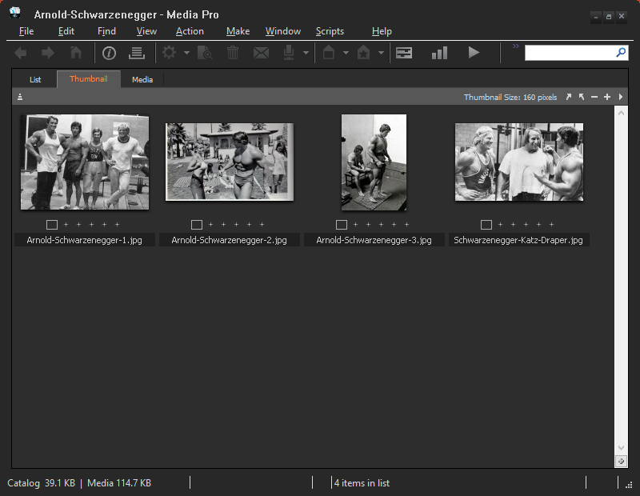
Precondition to executing the show selected command: photos must be selected
No photos selected

Slide 179
Precondition to executing the show selected command: photos must be selected
cs.selection != Undefined

Slide 180
An effect of the show selected command is to replace the set of showing assets
show
selected
2 hidden photos

Slide 181
An effect of the show selected command is to replace the set of showing assets
show
selected
cs'.showing = cs.selected

Slide 182
No change to the set of selected assets
show
selected
2 hidden photos

Slide 183
No change to the set of selected assets
show
selected
cs'.selection = cs.selection

Slide 184
No change to the set of assets in the catalog
2 hidden photos

Slide 185
No change to the set of assets in the catalog
cs'.assets = cs.assets

Slide 186
Summary of the effects of the “show selected” command
Precondition: cs.selection != Undefined
cs'.showing = cs.selected
cs'.selection = cs.selection
cs'.assets = cs.assets

Slide 187
Recap of the model
The model identifies things that are relevant
catalogs, assets, selection, hidden, showing, clipboard
The model defines the state of the application
the set of open catalogs, the state of each open catalog, the “current” catalog, the assets on the clipboard
The model defines the state of each catalog
catalog's assets, catalog's assets that are showing, catalog's assets that are hidden, catalog's assets that are selected
The model describes the effects of each command
cut, paste, hide selected, show selected

Slide 188
Table of Contents
Introduction to modeling, analysis, and Alloy
Learn a bit about the tool we will model/analyze – lots of screenshots
A model of the tool
Analysis of the model
The model, expressed in the Alloy modeling language
Analysis, expressed in the Alloy modeling language

Slide 189

Hey computer, please analyze the model: does paste undo cut?

Slide 190
Does paste undo cut?
Suppose we execute a cut command followed by a paste (to the same catalog).
Is the application the same after as before?

Slide 191
Does paste undo cut?
Suppose we execute a cut command followed by a paste (to the same catalog).
Is the application the same after as before?
This is analogous to an algebra expression where we subtract b from “a” and then add b:
a - b + b = a

Slide 192
Does paste undo cut?
Suppose we execute a cut command followed by a paste (to the same catalog).
Is the application the same after as before?
In other words, does the application have an algebraic property?

Slide 193
Results: the computer found examples of where the application is not the same after as before
Here's one example

Slide 194
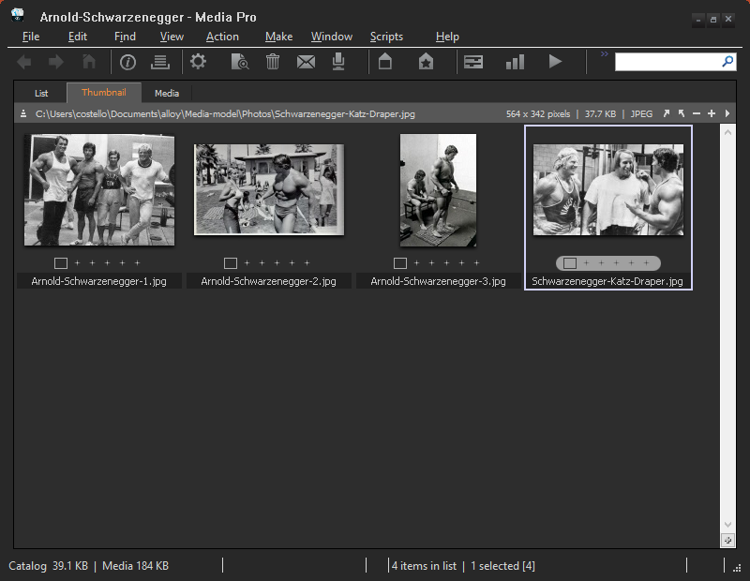
First, cut this photo

Slide 195
Here’s the clipboard

Slide 196

If we desired, we could paste the stuff in the clipboard to a catalog

Slide 197

This is the state of the application.

Slide 198

Select this photo and then do a cut command

Slide 199

Catalog after doing the cut command

Slide 200
Next, do the paste command

Slide 201

Catalog after doing the paste command

Slide 202
Before
After

Slide 203
More precisely, this is the before and after state

Slide 204
Before
After

Slide 205
Before
After
Before and after are different.
The clipboards differ.

Slide 206
The application does not have the algebraic property

Slide 207
Paste does not undo cut

Slide 208
Paste does not undo cut
The reason that paste does not undo cut is because cut replaces (overwrites) the contents of the clipboard and the paste doesn't retrieve the previous content.

Slide 209
Let's do a second analysis

Slide 210
Hey computer, suppose I changed the model so that the “hide selected” command retains the selection, i.e. cs'.selection = cs.selection
Would that violate anything?

Slide 211

Recall the invariant:

Slide 212
Results: the computer found examples of where the application violates the invariant
Here's one example

Slide 213
I used the hide selected command to hide two photos. The (erroneous) model says
cs'.selected = cs.selected

Slide 214
I used the hide selected command to hide two photos. The (erroneous) model says
cs'.selected = cs.selected
The selected assets are not a subset of showing. That violates the invariant.

Slide 215

Wow, a computer is able to analyze models and find counterexamples like those?

Slide 216
Yes, provided you express the model in the right language – Alloy.

Slide 217
The Alloy language
Alloy is a language. Like all languages, it takes study and practice to become fluent.
The previous slides gave you a sense for these modeling activities:
abstract the application
identify relevant things
describe the effects of the application's commands on the things
ask questions about the model -- ask the computer to analyze the model
Now it’s time to express these things using the Alloy language.

Slide 218
Table of Contents
Introduction
Learn a bit about the tool we will model/analyze – lots of screenshots
A model of the tool
Analysis of the model
The model, expressed in the Alloy modeling language
Analysis, expressed in the Alloy modeling language

Slide 219
Table of Contents
Introduction
Learn a bit about the tool we will model/analyze – lots of screenshots
A model of the tool
Analysis of the model
The model, expressed in the Alloy modeling language
Analysis, expressed in the Alloy modeling language
These slides are in Gentle-Introduction-to-Modeling-and-Analysis-part2.pptx
But before you look at that, please go through Gentle-Introduction-to-Alloy.pptx

